Slide 1


Overview
Project delivery for
Rikx portal
Project delivery
october 2023

Slide 2

What is the Rikx solution?
Rikx provides all the tools to bring the community together and help local initiatives grow. Everything in one platform to real-time track the progress and results and measure the local impact.
6 modules to help you automate, track and measure local impact.

Slide 3
Milestones | Timeline
Specification of work
Milestone 1:
Set-up basic branded portal (Rikx)
2 weeks after project kick-off
Milestone 2:
Configure modules
(Client & Rikx)
2 - 4 weeks
Milestone 3:
Training on usage & reporting (Client and Rikx)
2 - 4 weeks
Set-up portal in Rikx look-and-feel
Configure domain, email and security settings.
Configure module 1 t/m 6
Basic training
for usage
Testing and adding customization
Upload portal data
Add users and configure access
Testing with first project data
Translations

Slide 4
Milestones | Specification of requirements
Milestone 1 :
Setup basic
branded portal
Requirements from client:
- Preference for a domain
- User info to access the portal
- Main admin contact details
Responsible:
- Kick-off: Rikx & Get Prooved
- Configuration: Get Prooved
Milestone 2 :
Configure modules
& automation
Requirements from client:
- Availability for min of 2 process specification sessions
- First project data for testing
- Capacity for the first test round
- Creating basic content for website
Responsible:
- Information gathering: Rikx & Client
- Configuration: Get Prooved
Milestone 3 :
Testing
& customization
Requirements from client:
- Feedback from first test round
- Translations
- Portal data
Responsible:
- Translations: Get Prooved
- Customization: Rikx & Get Prooved
- Adding data: Rikx & Client

Slide 5
Rikx solution | 6 Modules
What are we going to set-up for you?
Module 1:
Projects flow
Monitor and track all projects including new project requests, with semi-automated approval processes, a project request form and a personalized environment for the social entrepreneurs.
Module 2:
Buyers flow
Automated process with a simple 3 step investment form for investors and an easy-to-use admin environment where you can actively monitor all investments and track the project progress.
Module 3:
Public website
Public website with multiple default pages including the public projects page with all active projects, the investment form and the project request form.
Module 4:
Value determination
Apply the Rikx value determination and create logins for the expert team to evaluate the projects.
Data gets saved and can be used for lessons learned.
Module 5:
CRM
Easy-to-use entrepreneurs and users environment to manage the different profiles (Social entrepreneurs, investors, administrators and reviewers) including various marketing and communication resources.
Module 6
Measure impact
A management environment for the Social Entrepreneurs to measure the impact of their projects. Both on project level, as participant level and simply share their results to Rikx.

Slide 6
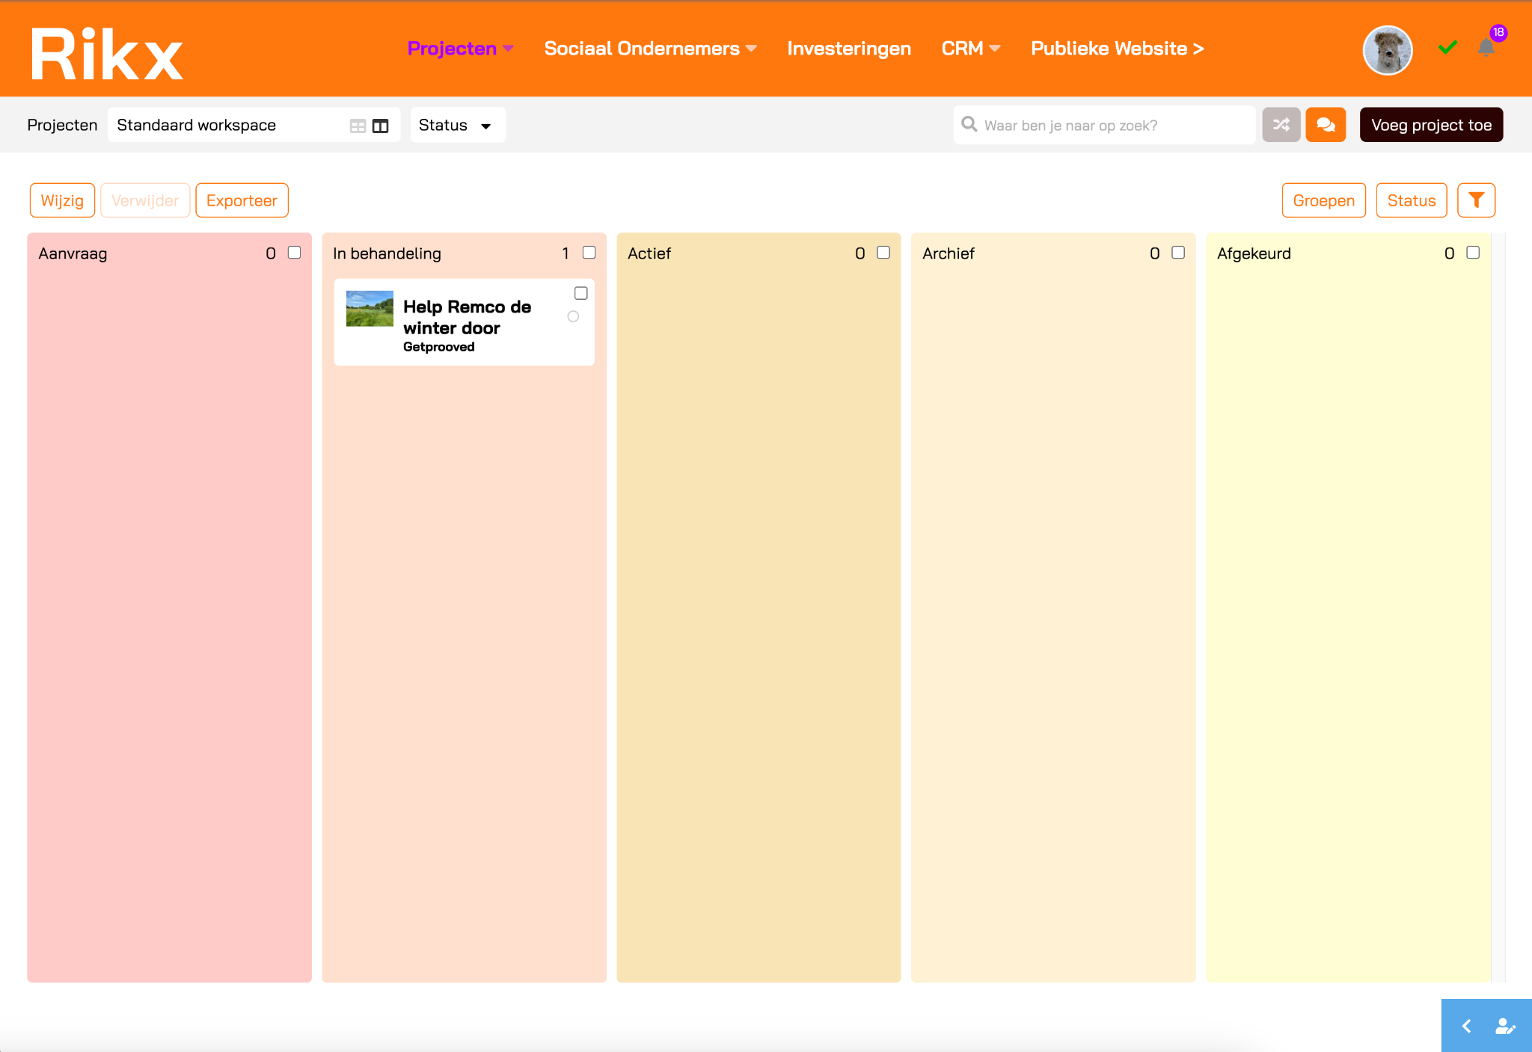
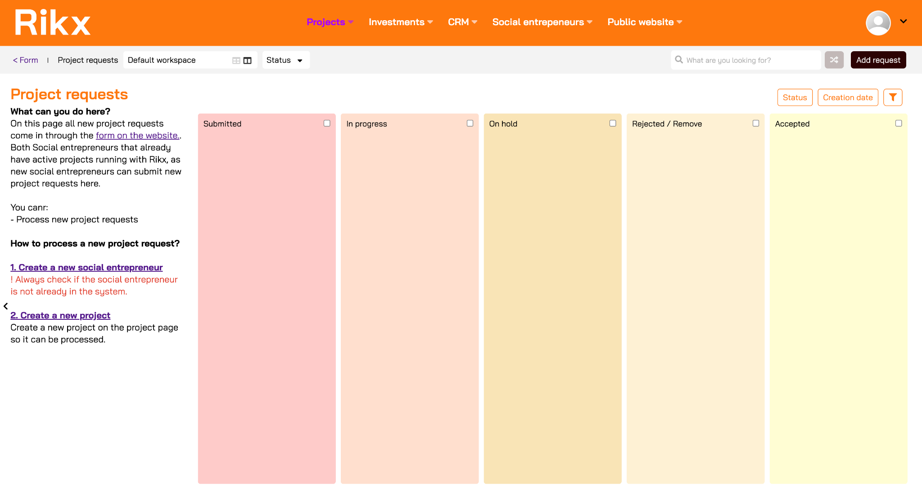
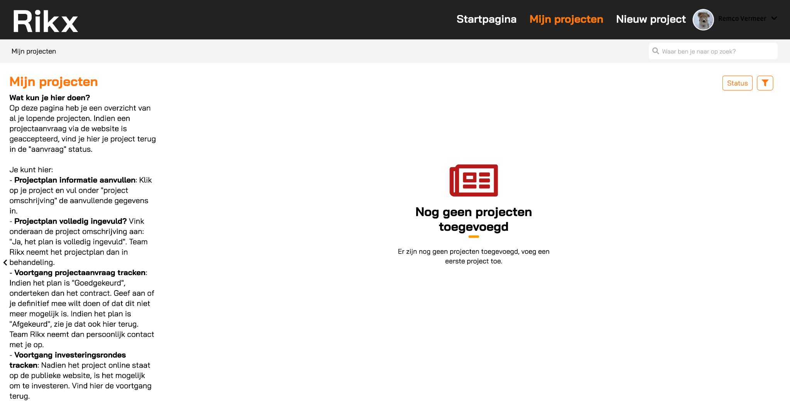
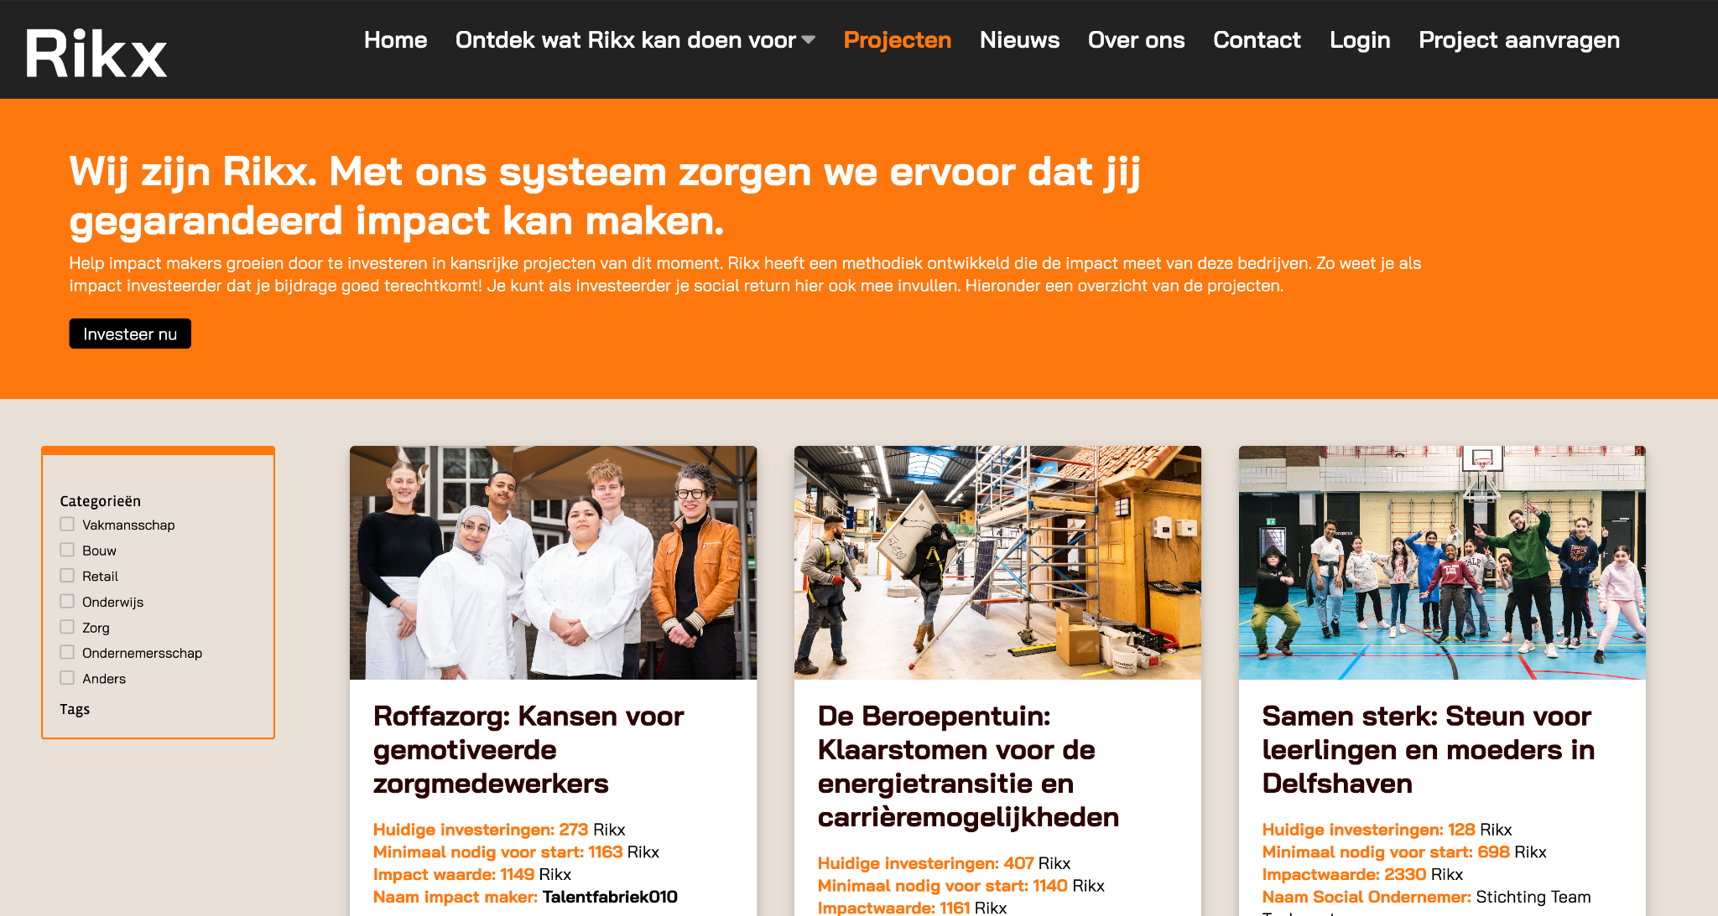
Module 1: Projects flow | Deliverables
Admin
Deliverable 1:
Projects overview
Features:
- Publicate projects
- Track and review project plan
- Automated notifications
Admin
Deliverable 2:
Project requests
Features:
- Automated notifications
- Review and approval
Social entrepreneurs
Deliverable 3:
My projects
Features:
- Update project plan
- Edit contract
- Final approval
- Latest news
- Automated notifications
- Submit new project requests
Public
Deliverable 4:
Published projects
Features:
- All published /
active projects

Slide 7
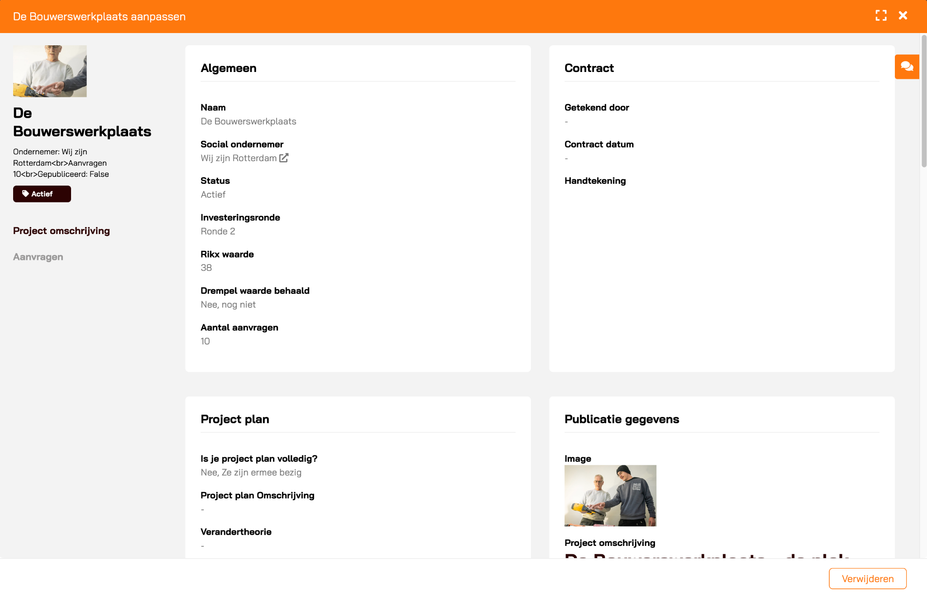
Module 1: Projects flow | Deliverables 1/2
2 admin environments to manage all projects and process and approve new project requests.
Deliverable 1: Projects overview
Features:
- Publicate projects
- Track and review project plan
- Automated notifications
Deliverable 2: Project requests
Features:
- Automated notifications
- Review and approval
Notes:
Project insights? Is er nog niet
Finalized projects archive?? Is ook nog niet vormgegeven

Slide 8
Module 1: Projects flow | Deliverables 3/4
A separate environment for social entrepreneurs to monitor and update their project details and a public projects page showing all published projects available for investments.
Deliverable 3: My projects
Features:
- Update project plan
- Edit contract
- Final approval
- Latest news
- Automated notifications
- Submit new project requests
Deliverable 4: Published projects
Features:
- All published / active projects
Notes:
Project insights? Is er nog niet
Finalized projects archive?? Is ook nog niet vormgegeven

Slide 9
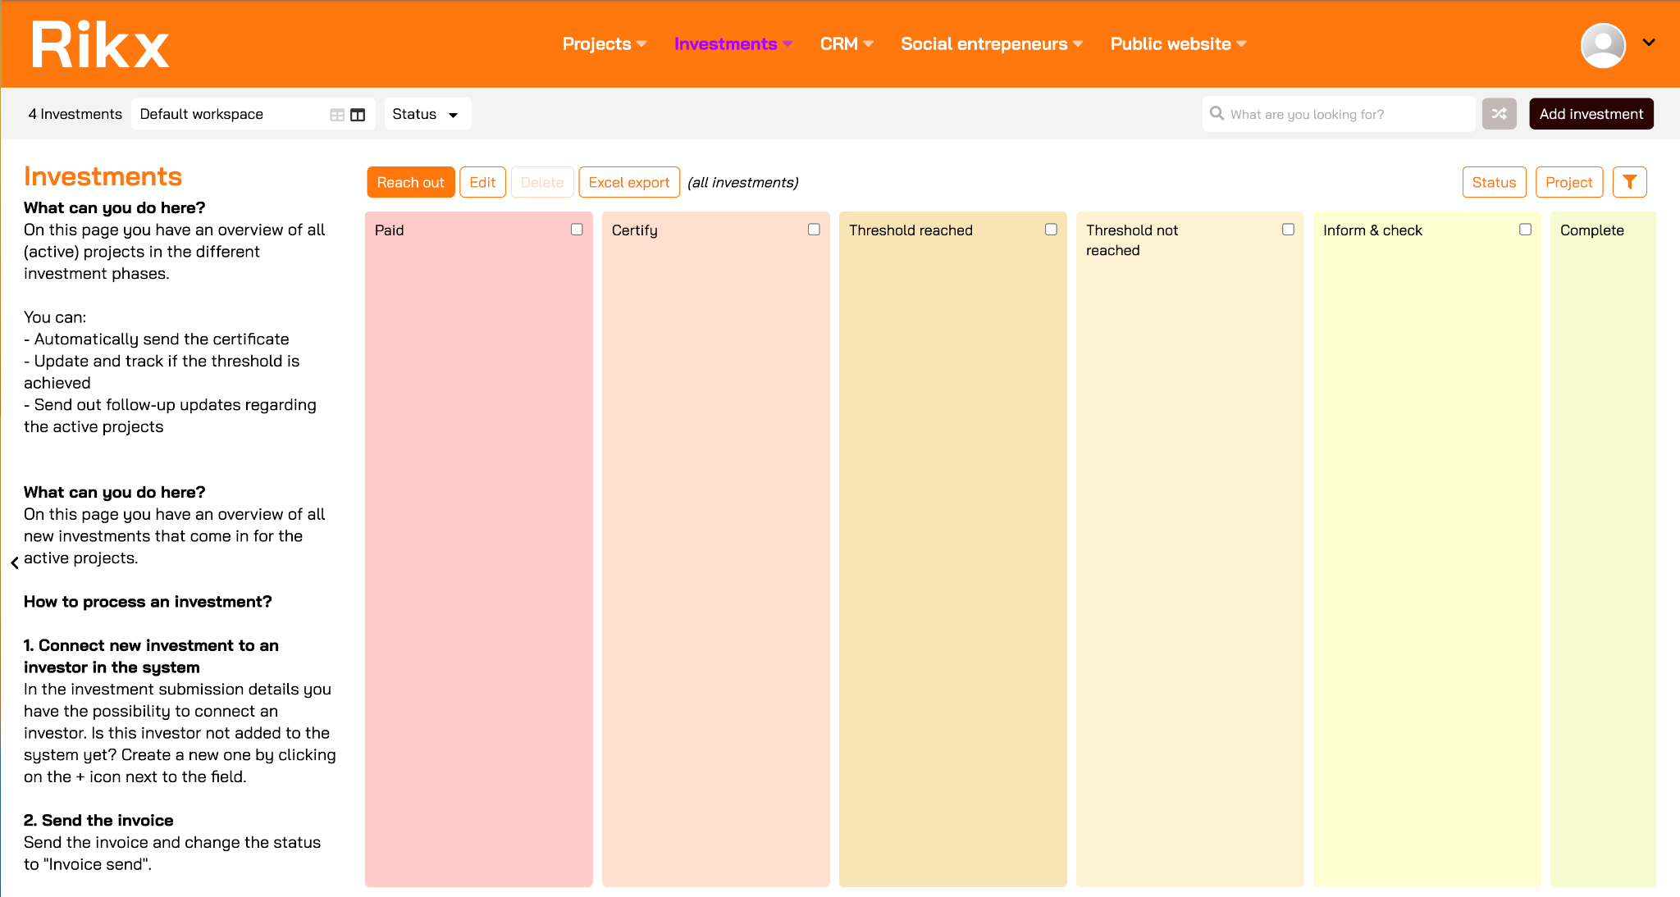
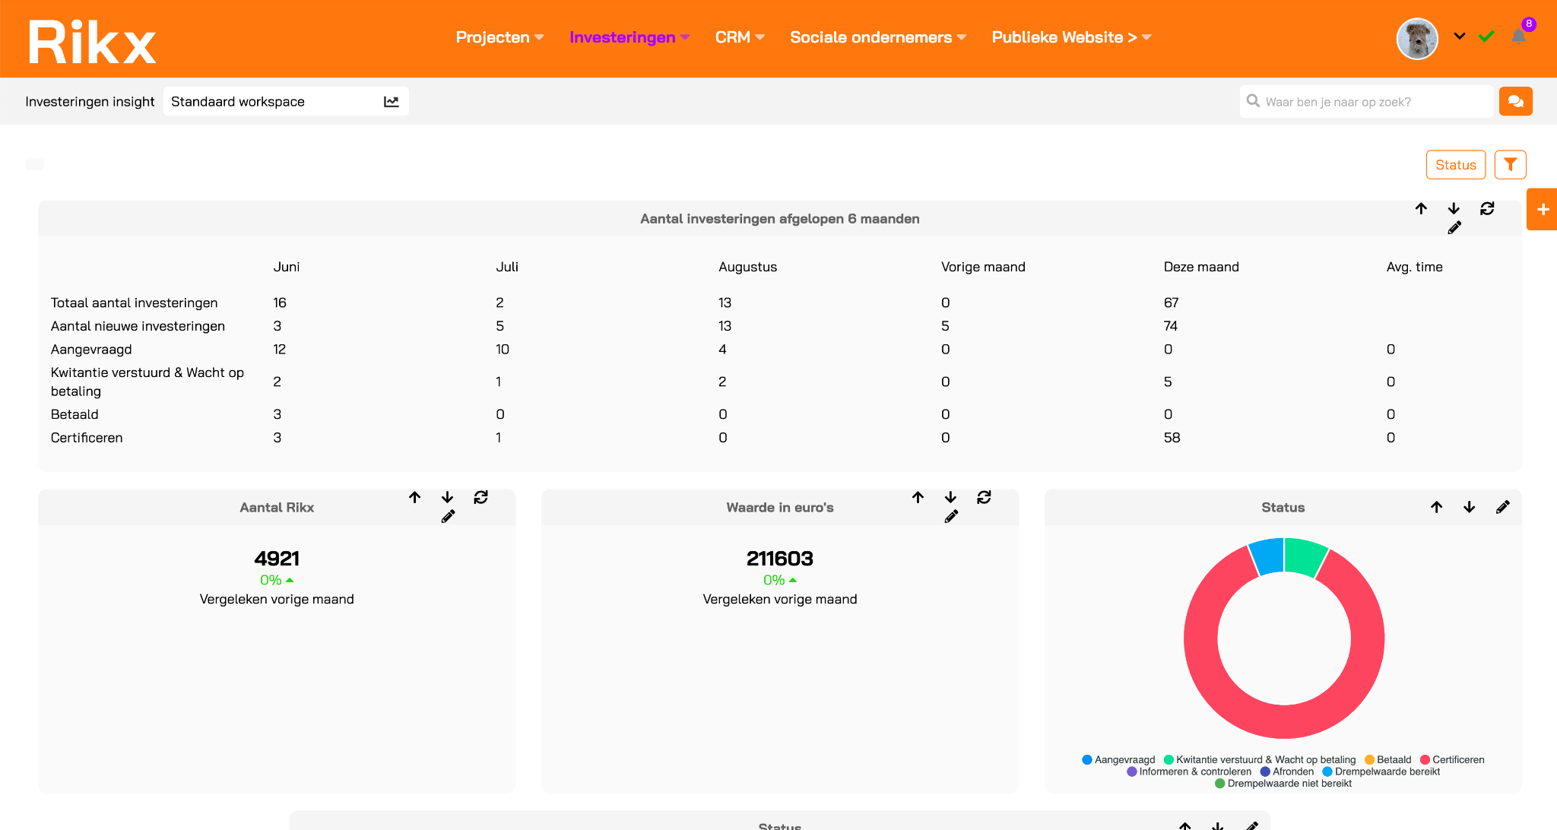
Module 2: Buyers flow | Deliverables
Admin
Deliverable 1:
Administration
Features:
- Receipt template
- Certificate template
- Automated notifications
- Connection with CRM
- Track threshold
Admin
Deliverable 2:
Investment form
Features:
- Public investment form
- Automatic calculations for the amount of Rikx
- Automated confirmation

Slide 10
Module 2: Buyers flow | Deliverable 1/2
2 admin environments to monitor the project investments and stay on top of the project progress and have a visual reporting dashboard of the investments.
Deliverable 1: Administration
Features:
Pipeline view to track all investments in the different phases and the threshold.
Automated email notifications to impact investors and admins during the different investment phases
CRM connection
Template for sending out the receipt for payment*
Template for sending out personalized certificates*
** Both templates can be customized to your needs.
Deliverable 2: Investment insights
Features:
Reporting dashboard

Slide 11
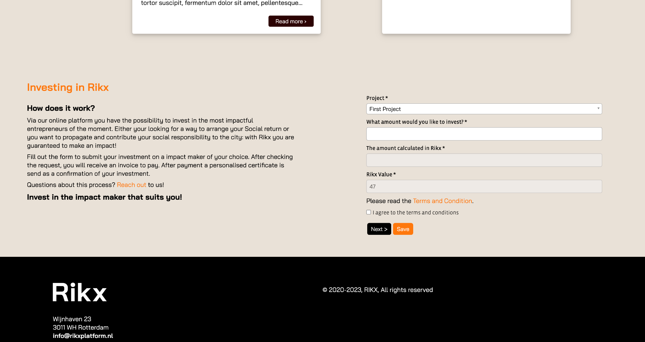
Module 2: Buyers flow | Deliverable 2
Public 3 step investment form for investors to invest in a local project.
Deliverable 2: Investment form
Features:
Public investment form
Automated calculations for the amount of Rikx
Automated confirmation to investors
** Investment criteria is customizable.

Slide 12
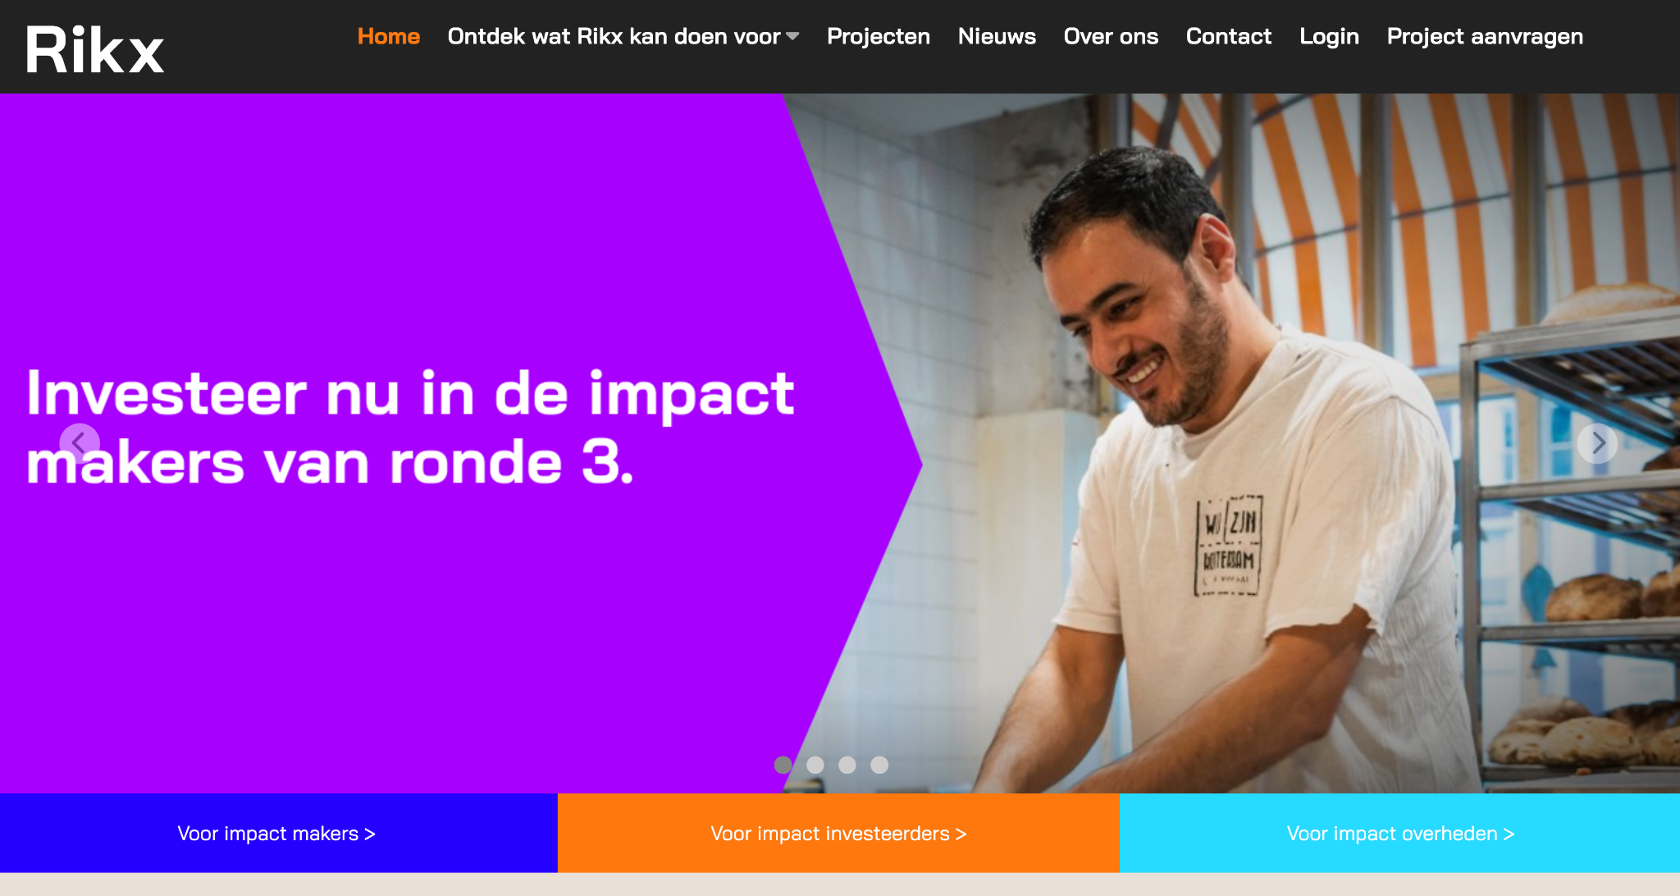
Module 3: Public website | Deliverables
A public website with default pages.
! The content, such as text and images, can be customized to your preferences including translations.
Deliverable 1: Homepage
Deliverable 2: About us
Deliverable 3: Contact
Deliverable 4: Project request form
Deliverable 5: Active projects
Deliverable 6: News

Slide 13
Module 4: Value determination | Deliverables
An admin environment to process the value determination and track reviews and a separate environment for reviewers to add and track their own reviews.
Deliverable 1: Value determination
Features:
- Calculated value determination
- Approve project round
- Track reviews
- Automated notifications
Deliverable 2: My reviews
Features:
- Export project summaries
- Add reviews
- Track your reviews
- Automated notifications

Slide 14
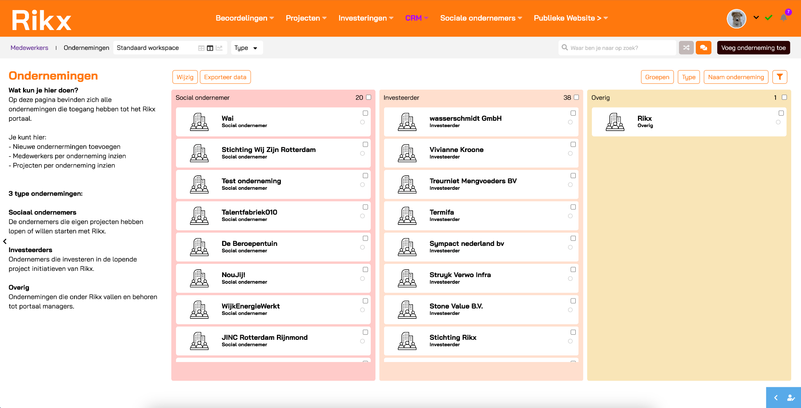
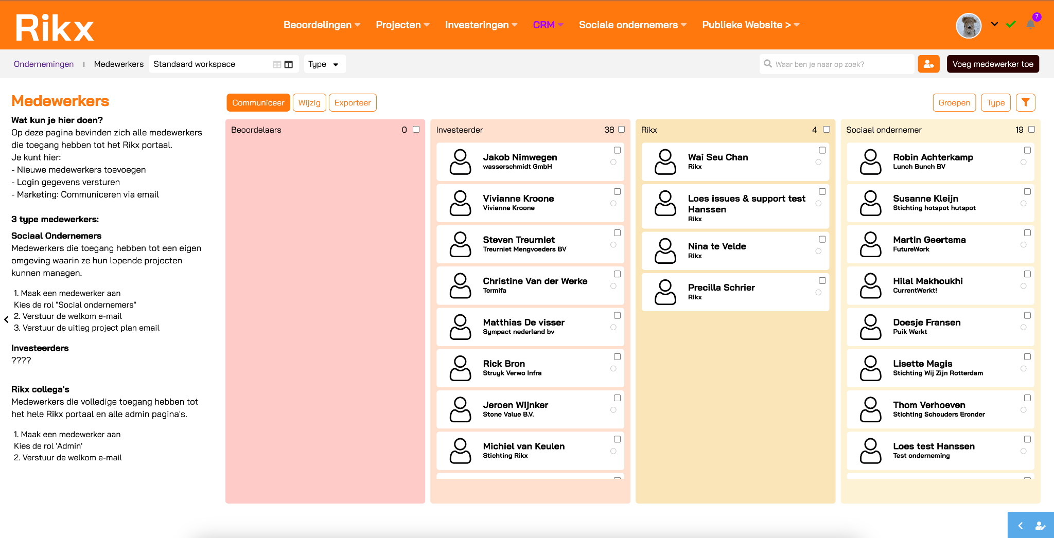
Module 5: CRM | Deliverables
An easy to use admin environment where you can manage all different profiles, including various marketing resources.
Deliverable 1: Entrepreneurs & users
Features:
- Manage profiles
Deliverable 2: Contact request page
Deliverable 3: Marketing and communication
Features:
- Marketing email templates

Slide 15
Module 6: Measure impact | Deliverables
Social Entrepreneur
Deliverable 1:
Monitoring framework with CSRD report
Features:
- Quarterly impact measurements easily added via their own environment
- Automated reminders for the impact measurements
- Automatically generated CSRD report with the latest results
Investors
Deliverable 2:
CSRD report
Features:
- Automatically generated CSRD report available for the investor via their own personalized environment
Social Entrepreneur
Deliverable 3:
Impact platform
Features:
- Track projects
- (Automated) impact measurements for participants
- One environment for participant details

Slide 16
Module 6: Measure impact | Deliverables
Social entrepreneur
Deliverable 1: Impact measurement
Features:
- Active and archived projects
- Impact measurements

