Slide 1


Automate, track and measure local impact
Solution overview
july 2023

Slide 2

Support your local impact entrepreneurs and activate impact investors to contribute to their local community.
Rikx provides all the tools to bring the community together and help local initiatives grow.
Everything in one platform to real-time track the progress and results and measure the local impact.

Slide 3
Rikx solution | 6 Modules
What does the Rikx solution look like?
Module 1:
Projects flow
Monitor and track all projects including new project requests, with semi-automated approval processes, a project request form and a personalized environment for the social entrepreneurs.
Module 2:
Buyers flow
Automated process with a simple 3 step investment form for investors and an easy-to-use admin environment where you can actively monitor all investments and track the project progress.
Module 3:
Public website
Public website with multiple default pages including the public projects page with all active projects, the investment form and the project request form.
Module 4:
Value determination
Apply the Rikx value determination and create logins for the expert team to evaluate the projects.
Data gets saved and can be used for lessons learned.
Module 5:
CRM
Easy-to-use entrepreneurs and users environment to manage the different profiles (Social entrepreneurs, investors, administrators and reviewers) including various marketing and communication resources.
Module 6:
Measure impact
A clear monitoring framework to share their results with Rikx, a management environment for the Social Entrepreneurs to measure and prove the impact of their projects. Both on project level, as participant level and a CSRD report.

Slide 4
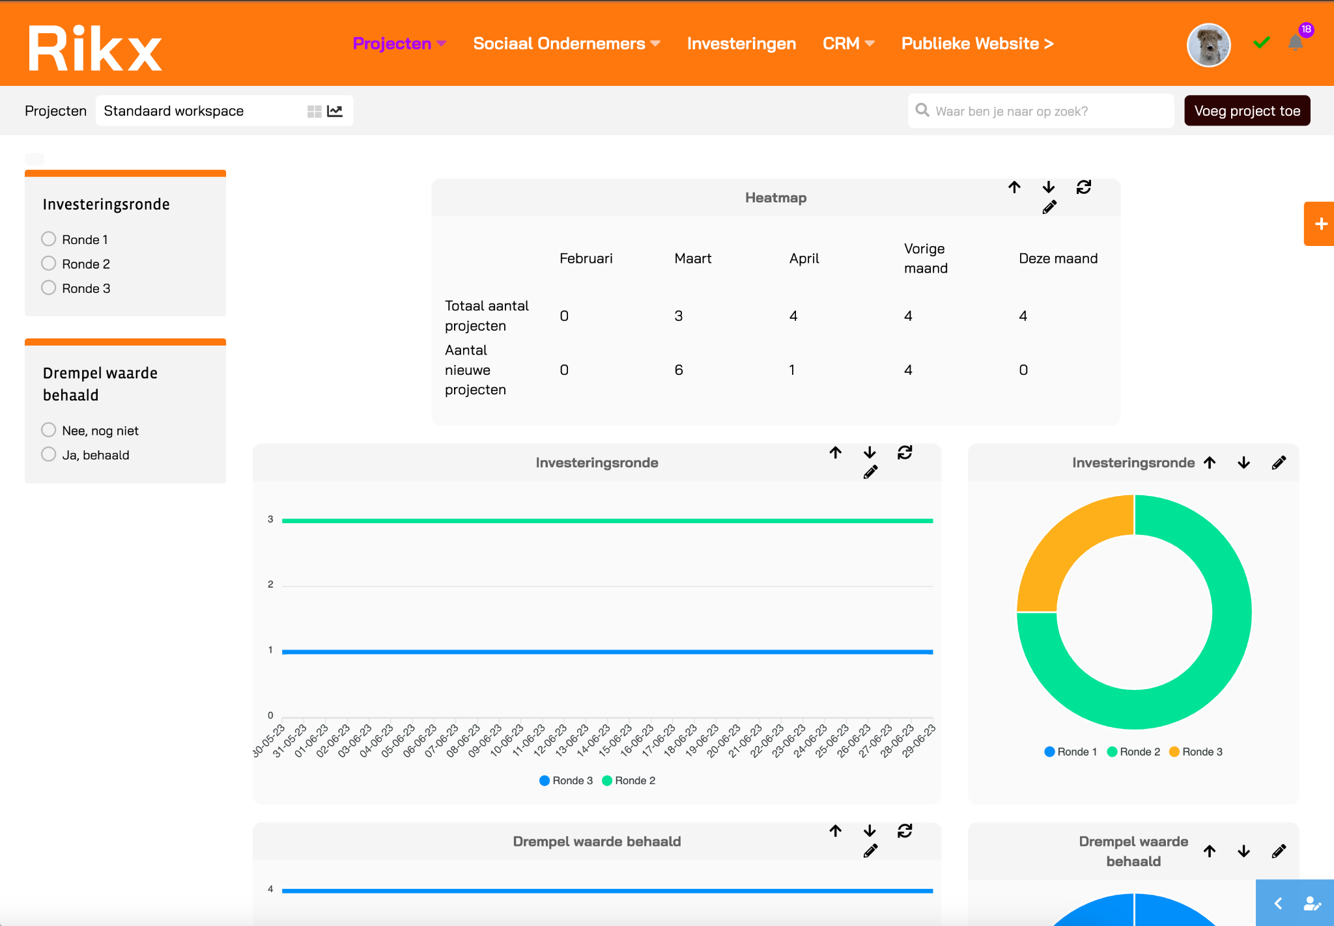
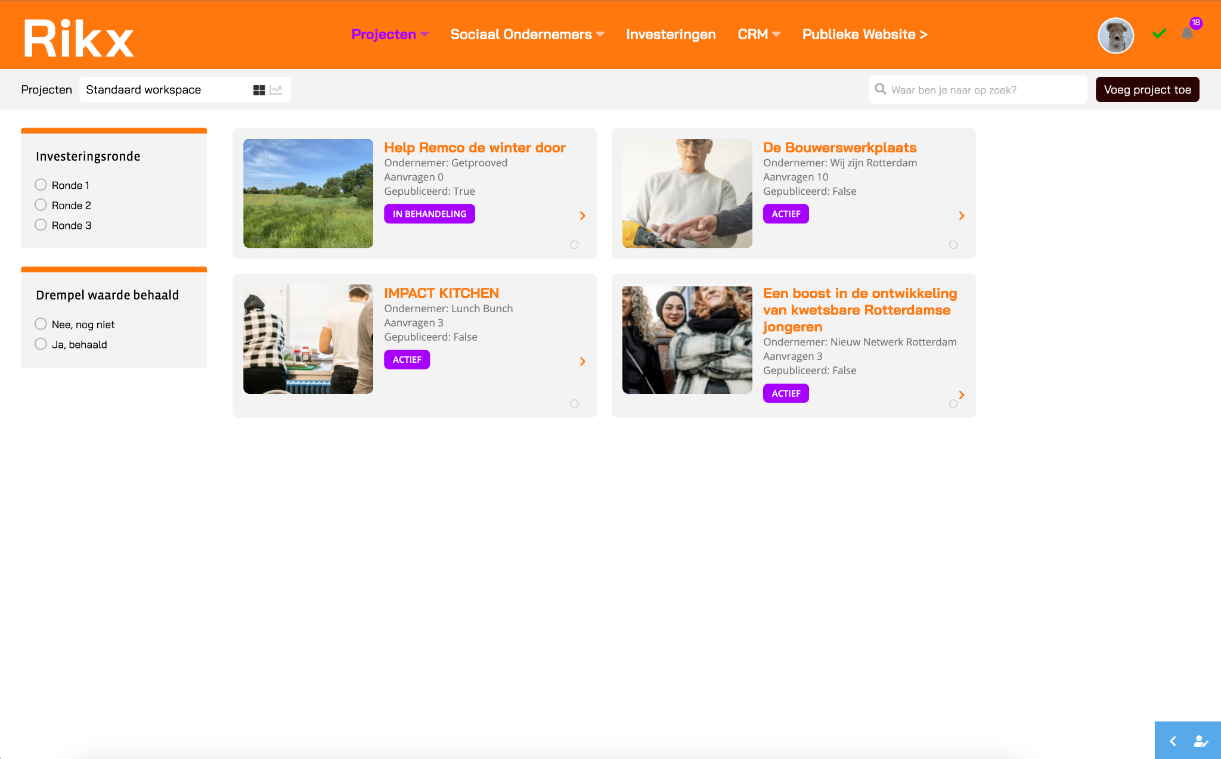
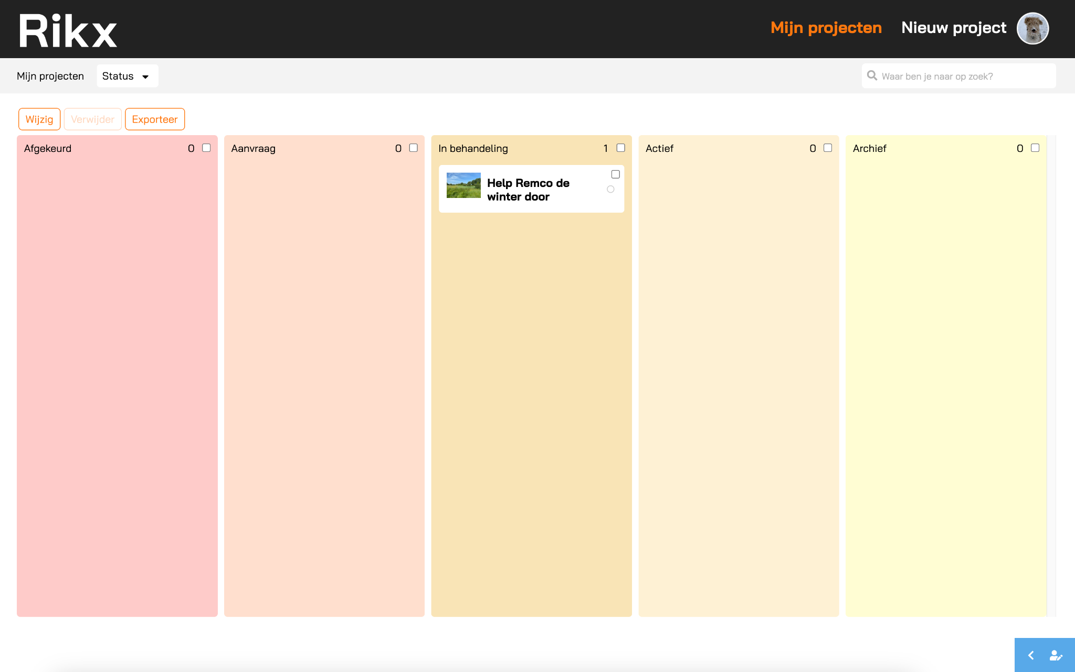
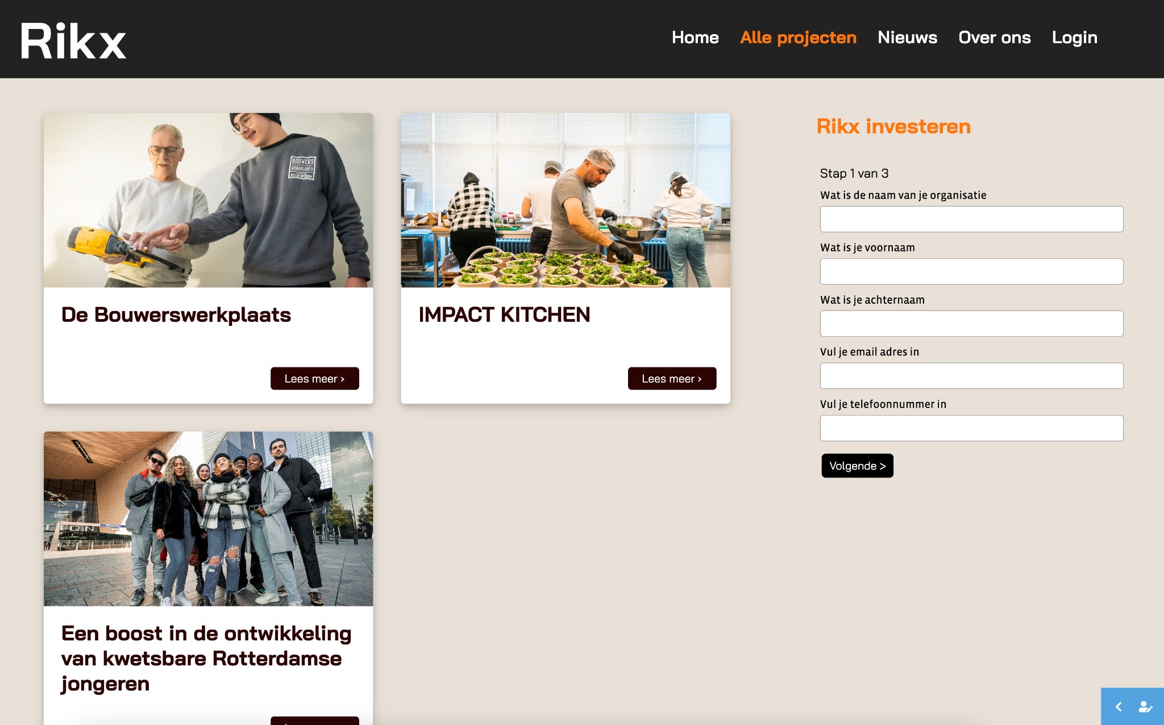
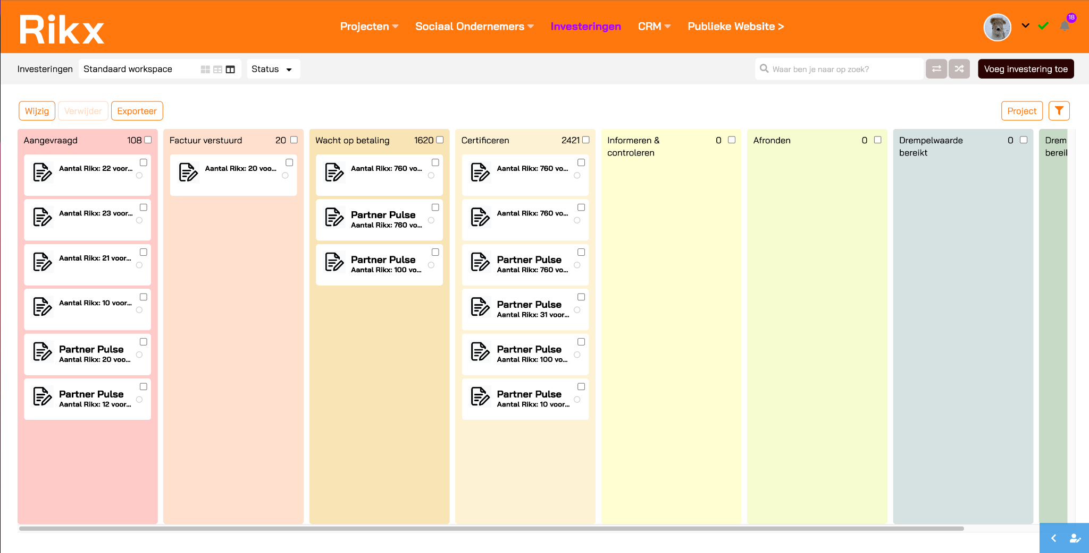
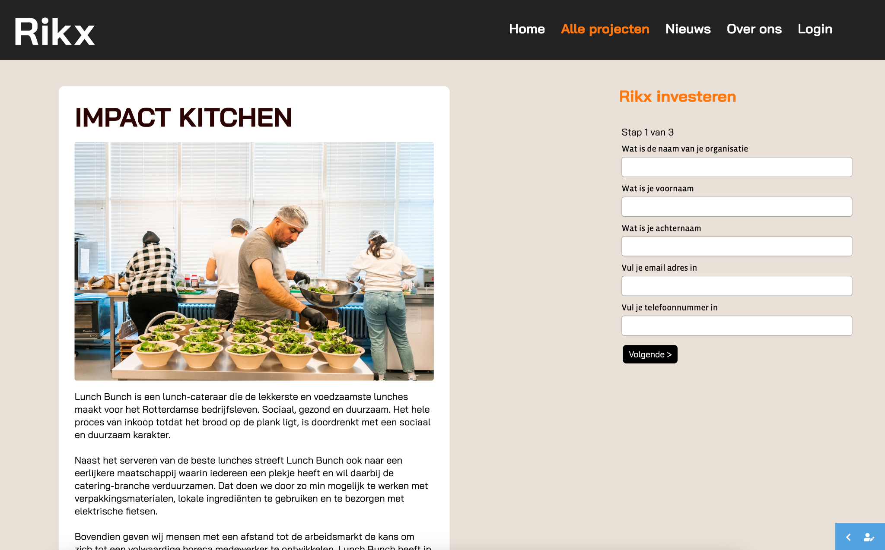
1 portal | 3 environments
Monitor, track and measure local impact
Admin
environment
All important data centralised in one environment to manage, monitor and measure local impact.
Impact
Entrepreneurs environment
Easy-to-use, personalised environment for entrepreneurs to monitor their projects and measure their results.
Public
environment
Public website with a projects page and a simple three-step investment process for investors.

Slide 5
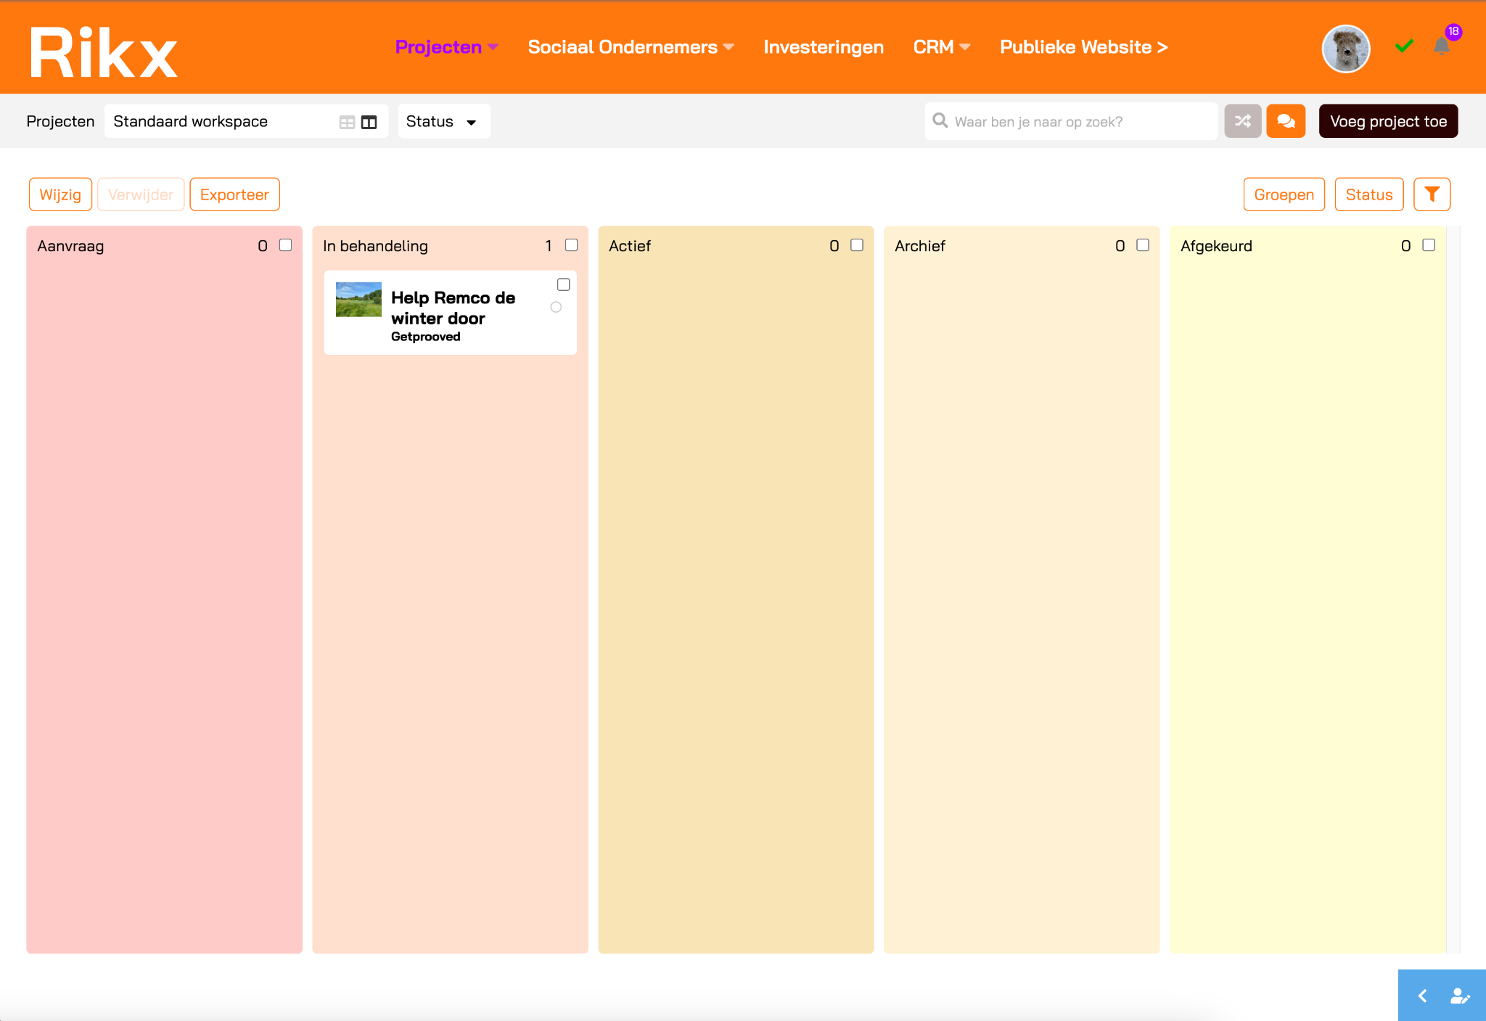
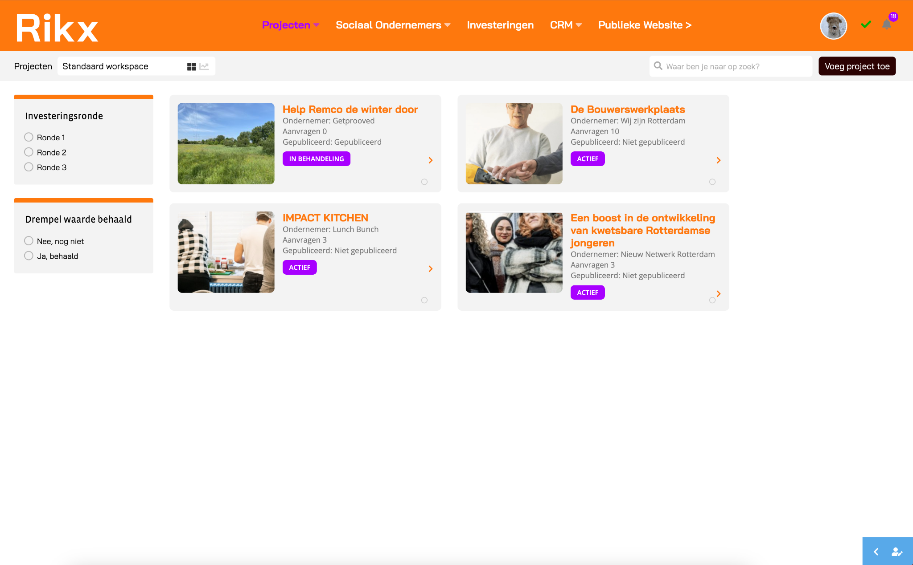
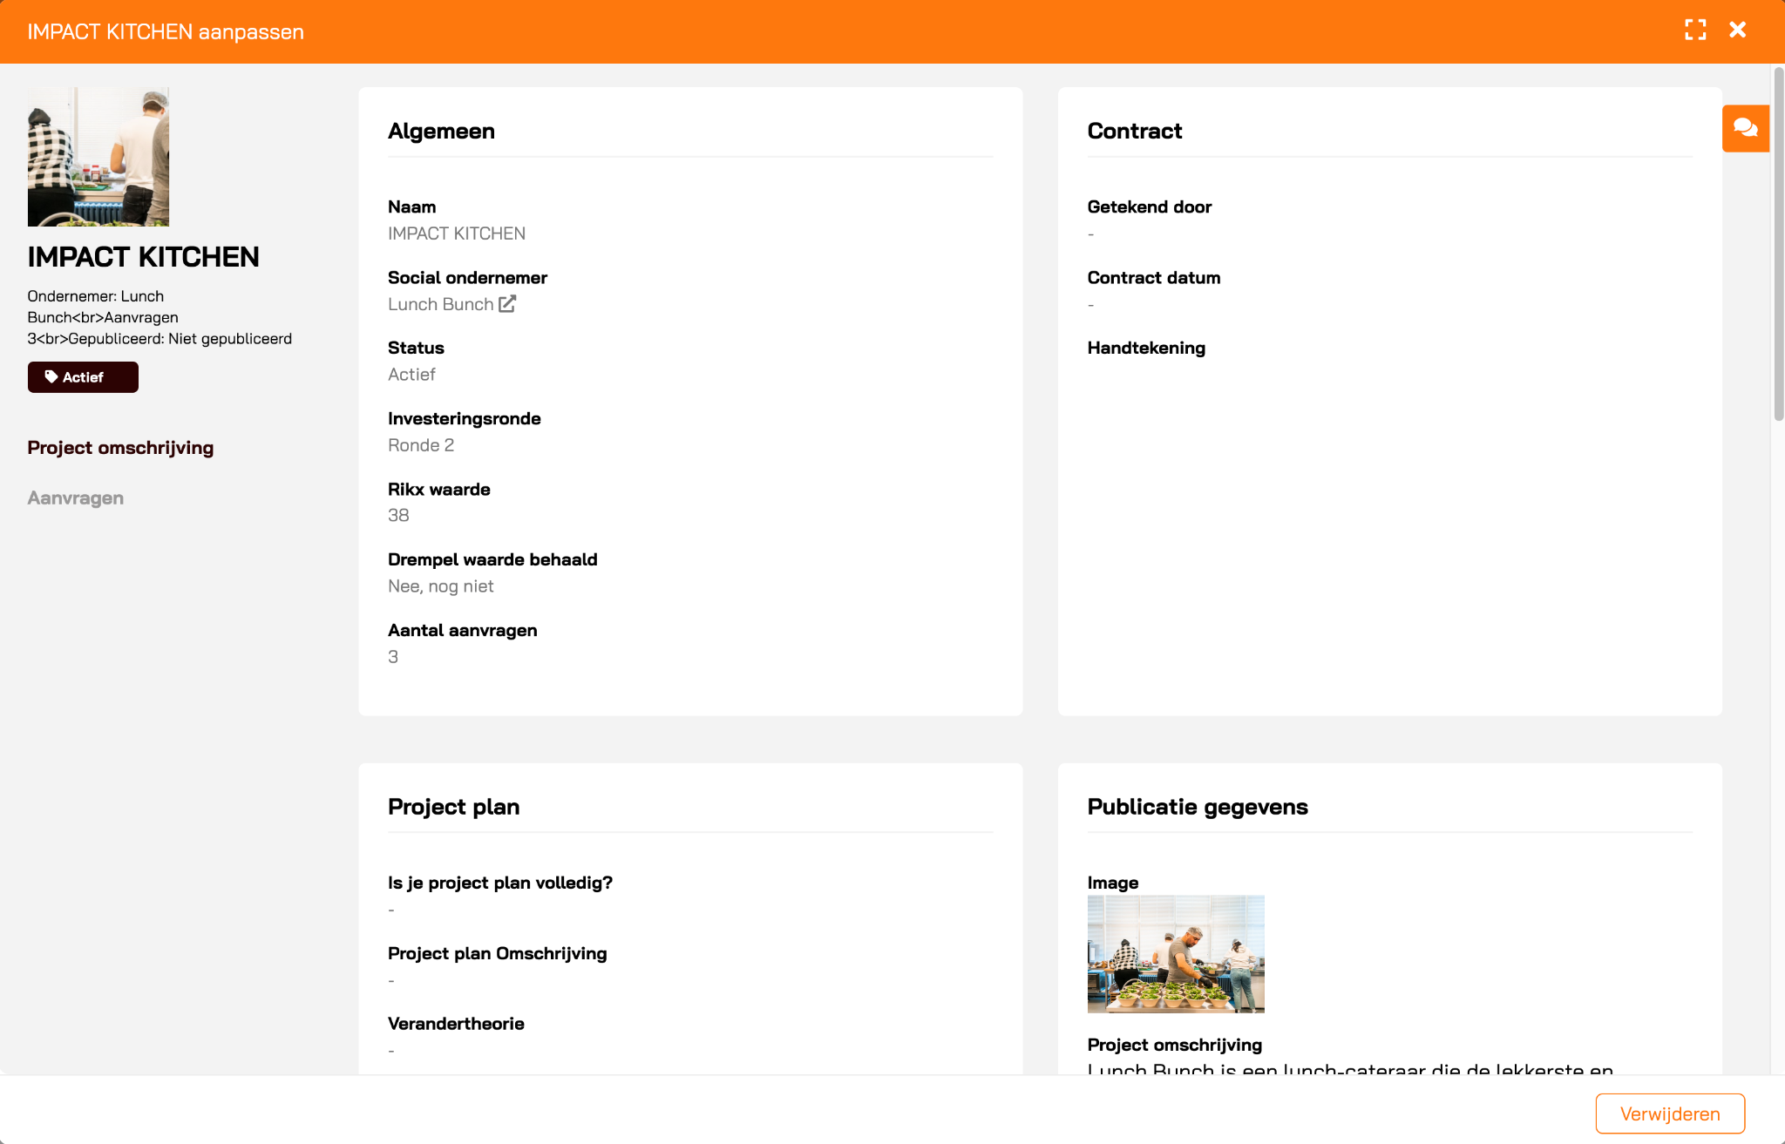
Module 1: Projects flow | Admin environment
Monitor, track and measure local impact
(Automated) approval process for new project applications
Automated notifications about new project applications from entrepreneurs.
All project data in
one place
Every project detail in one environment with a detailed overview of each project
Easily track
project progress
Insight into the progress of each active project with automated counters showing the total amount of investments in numbers and valuta.
Visual reporting dashboard to measure impact and progress
Detailed visual reporting on the projects and their individual impact and progress.

Slide 6
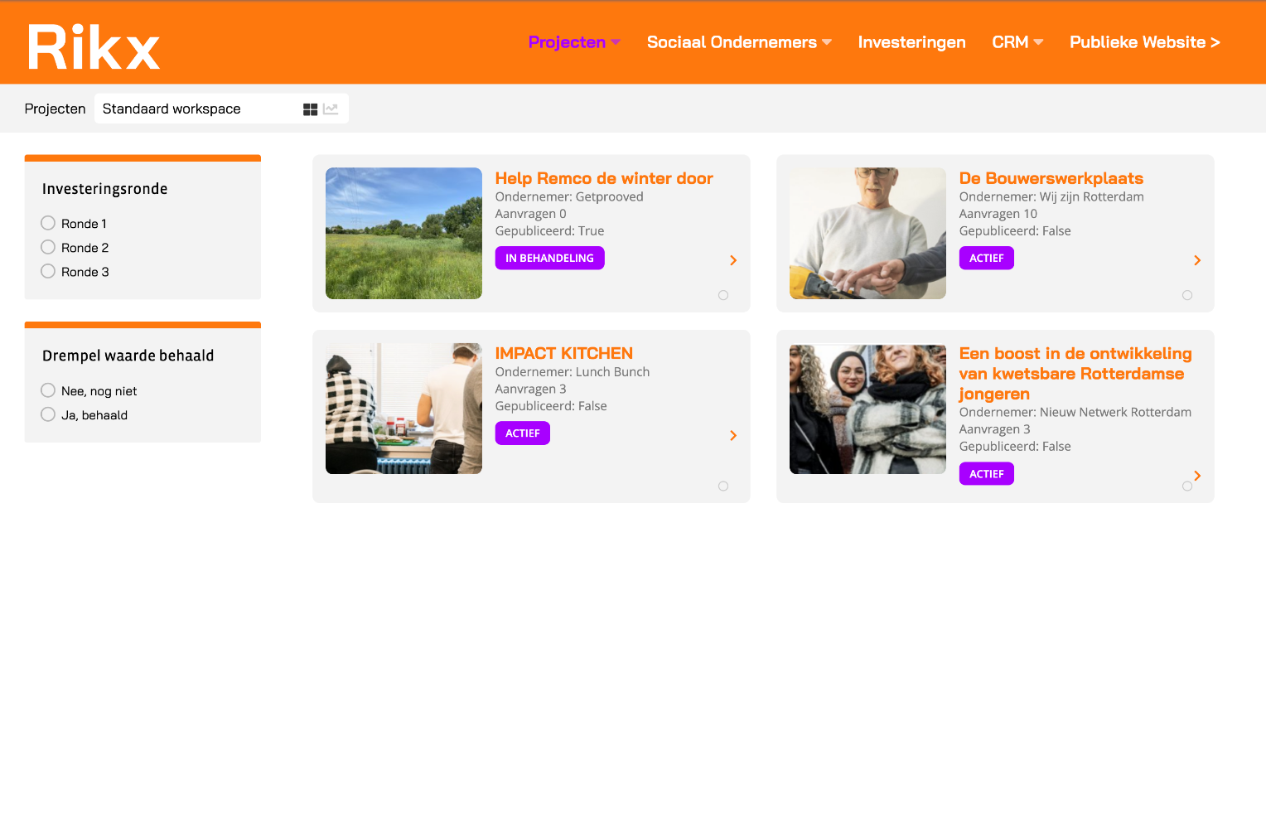
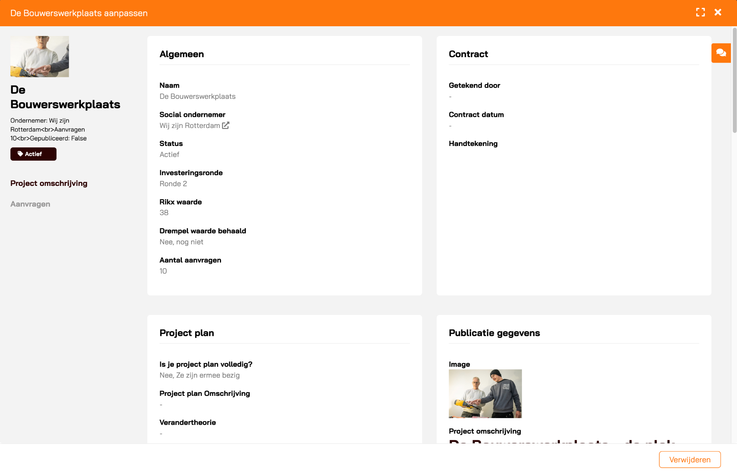
Module 1: Projects flow | Admin environment
All important project data in one place to monitor progress and measure impact.
Overview of all project details, including contract, project plan and investments, in one environment.
Separate pipeline for new concept projects with approval process
Customization:
In the test rounds it’s possible to extend or adjust the basic project criteria.
Notes:
Projects intern
- Overview van alle actieve projecten
- Management omgeving om de status van de projecten, de investeringen en de resultaten te tracken
- Per project inzicht in project plan, investeringen, contract
Concept projects pipeline
- Overview van alle projecten in concept
Projects (publiek)
- Beschikbare projecten om in te investeren in 1 oogopslag
- Makkelijk en snel investeren via formulier

Slide 7

Module 1: My projects | Impact entrepreneurs environment
Easy-to-use environment for the impact entrepreneurs to monitor their projects and apply / request new projects.
Separate personalised environment for each entrepreneur with their own login credentials.
Limited access to project details, they only see what they need to see.
They can track the progress of their projects real time as they move through the pipeline.
Automated approval process for new project applications.
Notes:
- Eigen inlog en omgeving binnen het portaal waarin ze hun eigen projecten kunnen zien en nieuwe projecten kunnen aanvragen / indienen
Status project tracken (investeringen etc.)
Geautomatiseerde flow voor de goedkeuring van nieuwe ingevoerde projecten

Slide 8
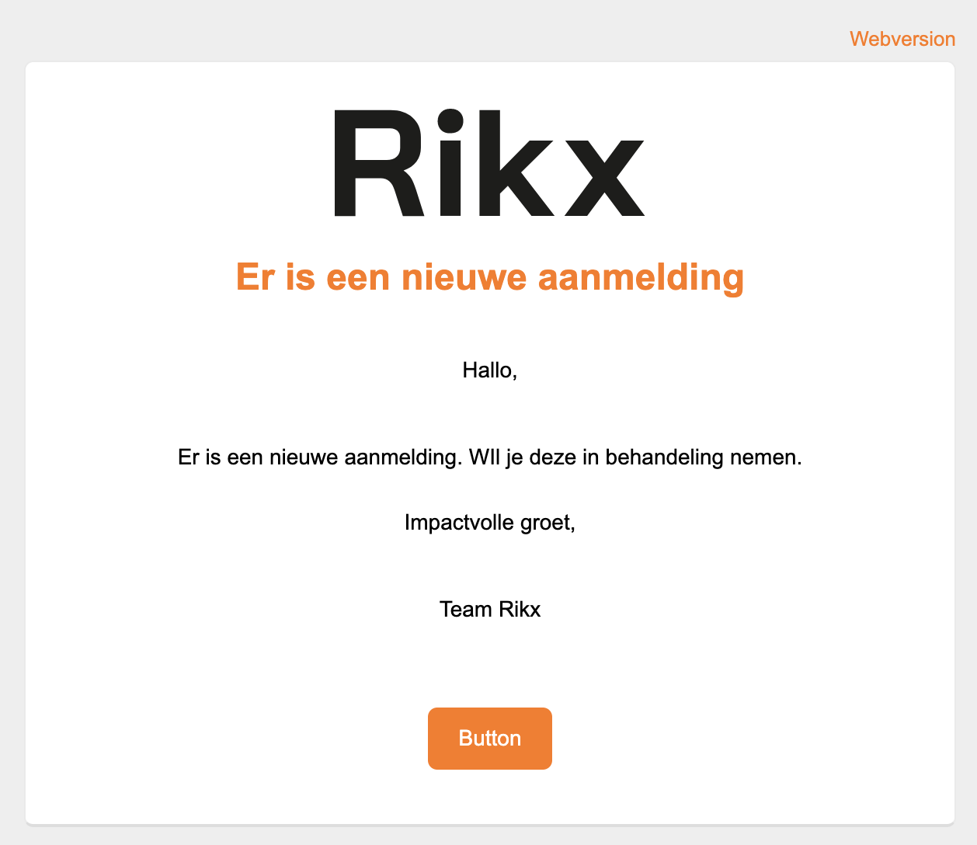
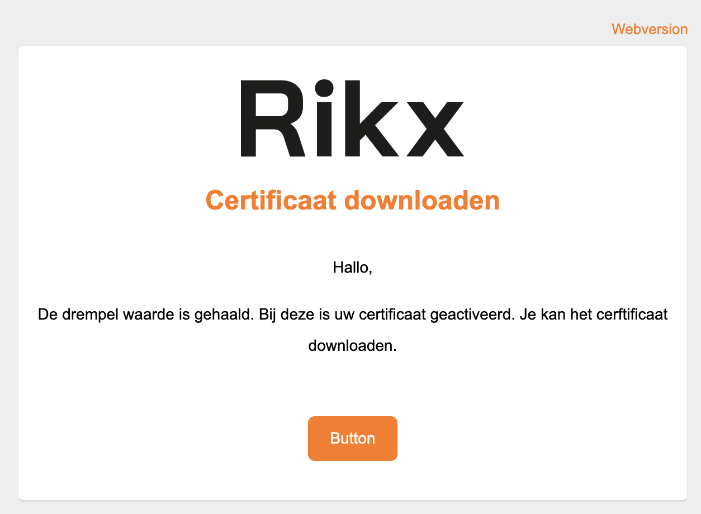
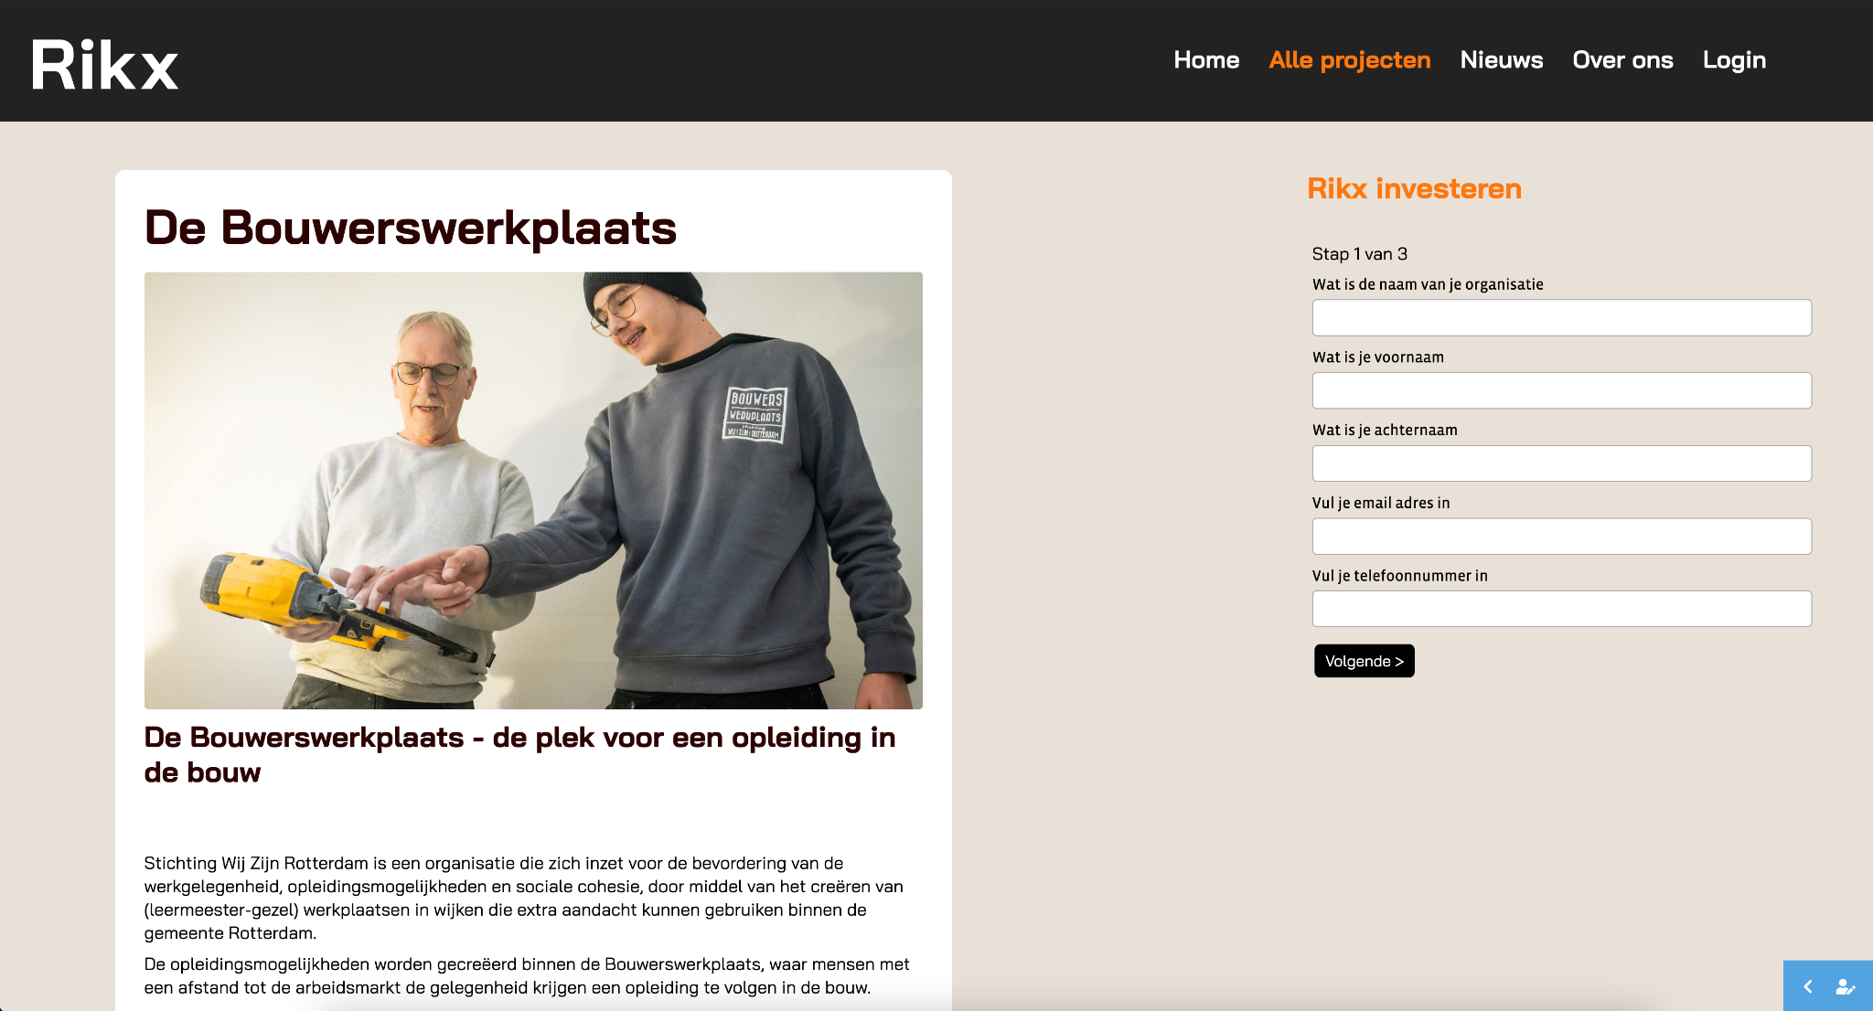
Module 2: Buyers flow | Admin environment
Automated process to actively monitor project investments
Simple and quick investment process
In a simple three-steps-process impact investors fill out their contact-, invoice- and investment details.
Automated notifications about new investments
Impact investors automatically receive a confirmation of their investment and an automated notification is send to the admin.
All investment details
in one place
Manage all important investment details, centralized in one place to easily track
the progress.
Automatically generated certificate for buyers
When the threshold is achieved, an email with a certificate is automatically send to everybody who invested in the project.

Slide 9
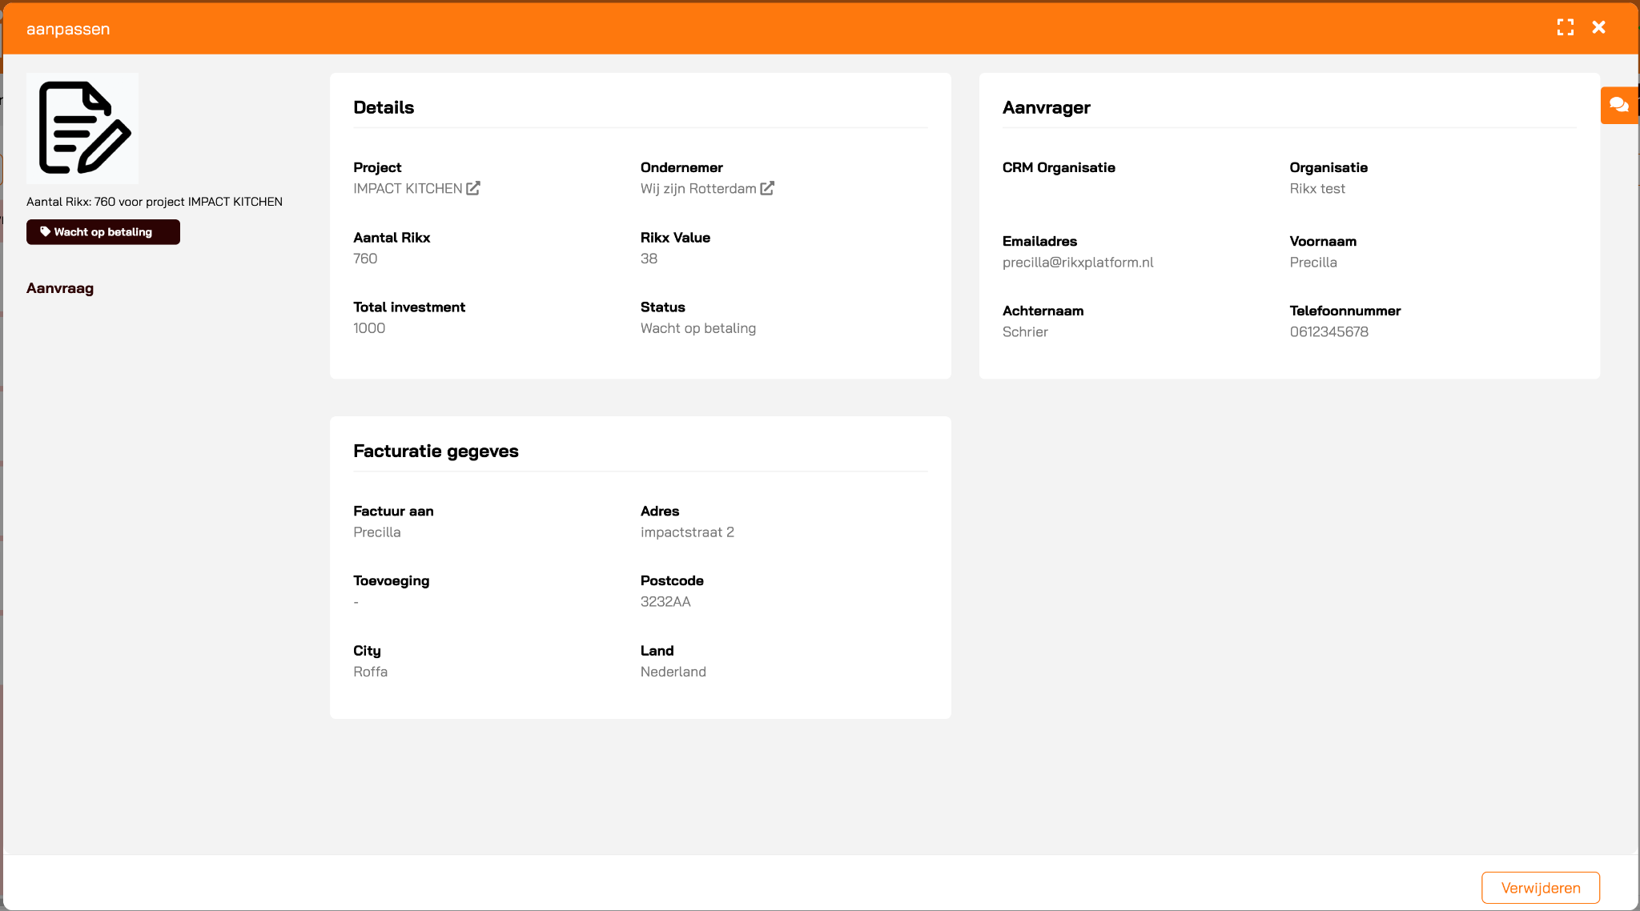
Module 2: Buyers flow | Admin environment
An easy-to-use environment to monitor the project investments and stay on top of the project progress.
Pipeline view of all investments in the different phases
Automated email notifications to impact investors and admins during the different investment phases
Filter on project to track the progress per project or use the different views to display the data
Customization:
The investment process can be configured to your standards

Slide 10

Module 3: Website | Public environment
Public website with a clear overview of all active projects that are open for investments
Public website completely branded in your look-and-feel
Standard, customizable website pages including a home, blog and about us page.
Active projects automatically display on the public projects page, everything is managed in the projects admin environment.
Easy three-step-process to invest
Customization:
The public pages can be customized with your own branding guidelines.

Slide 11
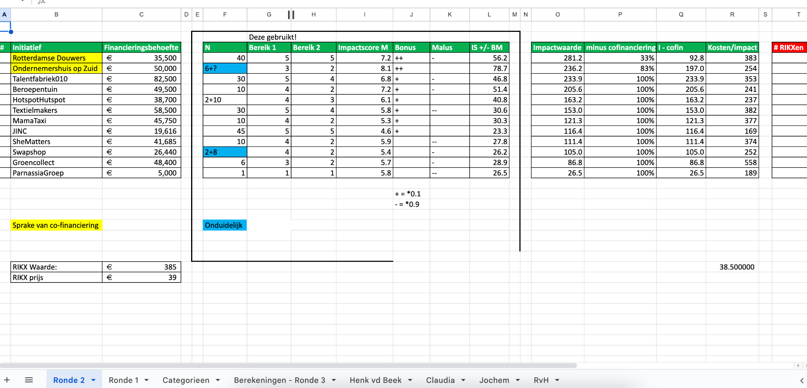
Module 4: Value determination
Applying the Rikx methodology in the automation flow.
Value determination
Using the Rikx methodology. Connecting the data of the projectplans to the calculation of Rikx
Login for the expertteam
Every expert team member will have their own environment to read and value the selected projects
All data is captured
All data is managed from project request to value determination. All stored in one database.
Merge data with other rounds and cities
Connect data to create useful insight throughout different rounds and even different cities

Slide 12
Module 4: Value determination
An automated value determination process based on the reviews of the expert team determining the Rikx value for each project
Expert team review each project in their own accessible environment with personalised login credentials
All data is automatically calculated based on the Rikx methodology and stored under the project details
Easy-to-use access to all individuals reviews of the expert team members in a clear overview.

Slide 13
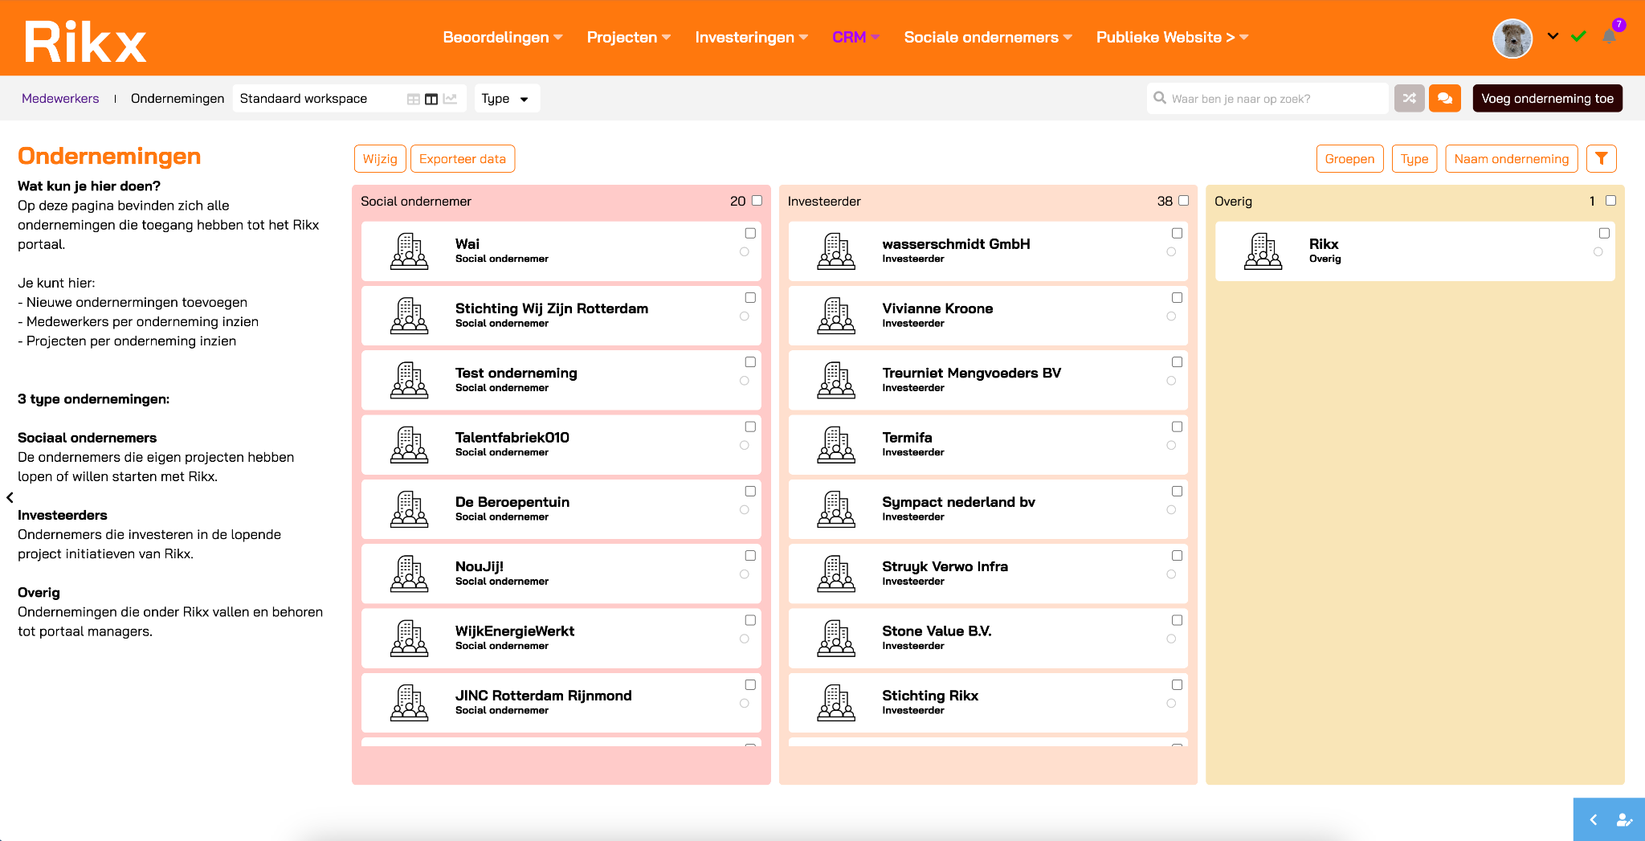
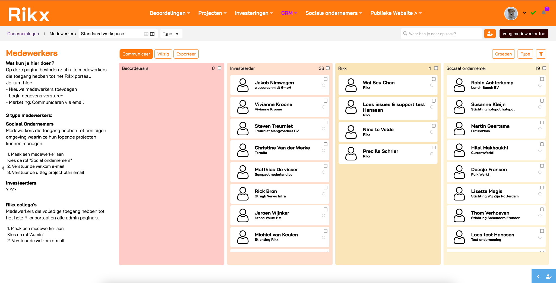
Module 5: CRM databases | Admin environment
An easy to use admin environment where you can manage all different profiles, including various marketing resources.
Database with all the account details and different profiles including an overview of all users from that account.
A separate database with all users that have access to the Rikx environment including contact and personal details and possibility to manage login credentials for invites or password resets.
Possibility to use the user database for marketing purposes including ready to go email communications.

Slide 14
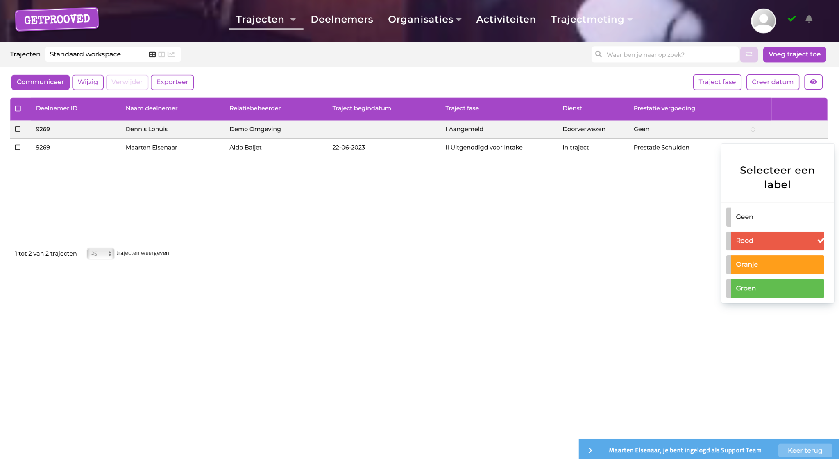
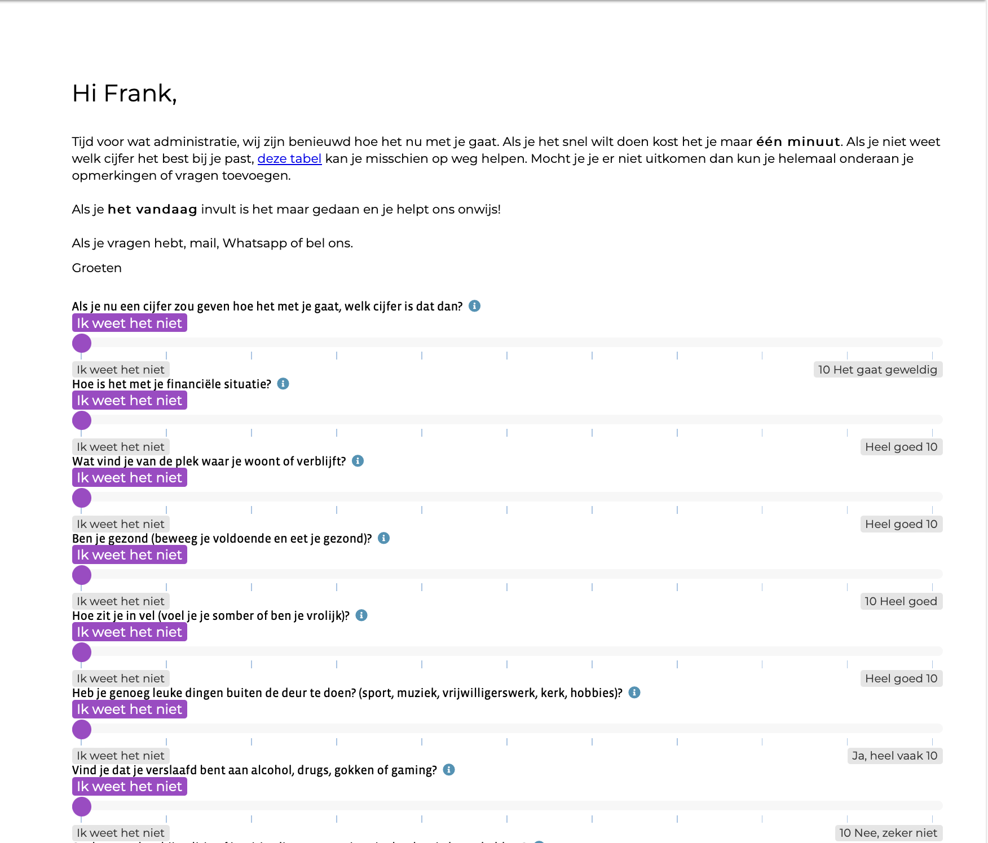
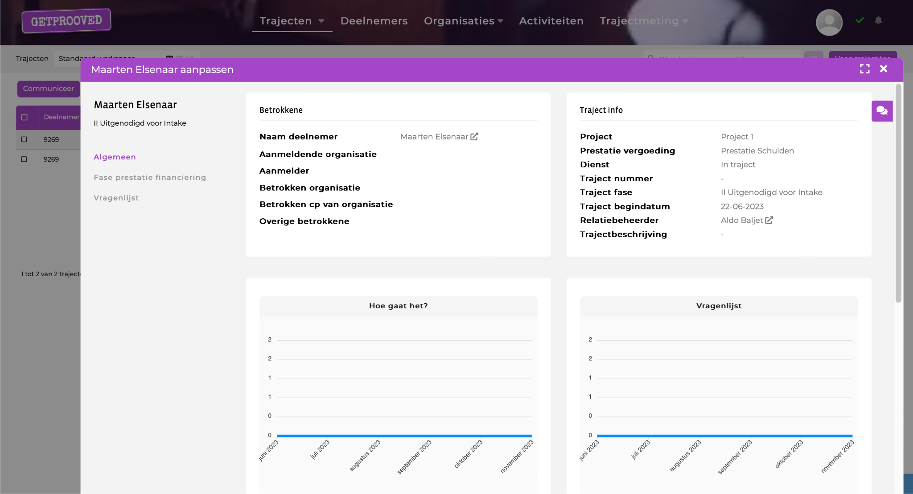
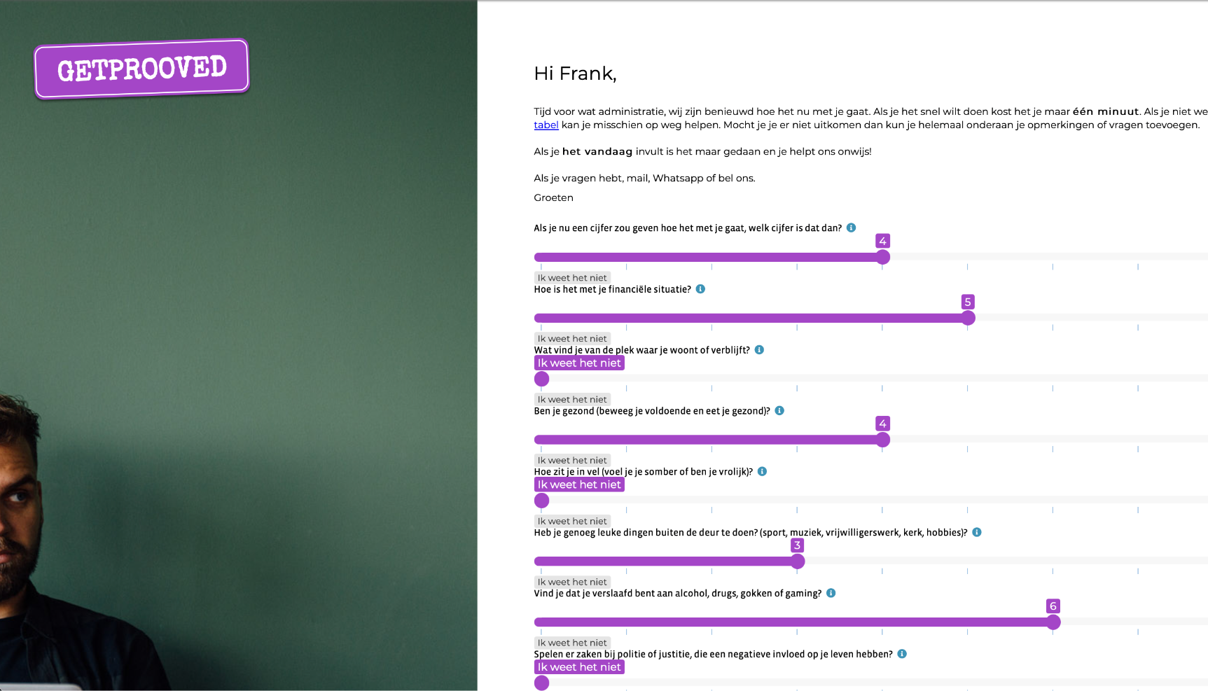
Module 6: Measure Impact
Personalised impact platform to prove and increase impact
A customisable environment for tracking, sharing and signaling
Centralise all participants, activities and stakeholders information in one user friendly cloud environment.
Enrich profiles by
measuring progress
Set fixed moments in time where the project stakeholders are automatically questioned about individual progress. This will enrich the data profiles with impact information.
Prove your impact, learn and share results with Rikx
Which actions lead to which results, the build-in reports help you to improve your Theory of Change and prove your social impact. All results can be easily shared with Rikx through the platform.
Notes:
om informatie en voortgang over individuele trajecten, deelnemers en stakeholders vast te leggen

Slide 15
Module 6: Measure impact | Your own impact platform
A customisable environment for the entrepreneurs dedicated to gather, process and measure the impact of active projects and cases.
Overview of all individual cases, including the cases that are not part of a Rikx project.
All information in one place, participant details, project details, stakeholders, progress etc…
Smart signaling helps you to create data cross sections to plan your best next actions.

Slide 16
Module 6: Measure impact | Smart data collection
Easily measure progress via (semi) automated personalised questionnaires.
Measuring progress with project stakeholders can become a completely automated process.
All progress measurements are directly visible in the case details and will be updated each time a questionnaire is filled in.
Plan your actions based on changes in the data
Customization:
Before the personalised environment is created the entrepreneurs get the possibility to deliver input for additional impact questions. This is also possible in a later stage.
Notes:
Projects intern
- Overview van alle actieve projecten
- Management omgeving om de status van de projecten, de investeringen en de resultaten te tracken
- Per project inzicht in project plan, investeringen, contract
Concept projects pipeline
- Overview van alle projecten in concept
Projects (publiek)
- Beschikbare projecten om in te investeren in 1 oogopslag
- Makkelijk en snel investeren via formulier

Slide 17
Module 6: Measure impact | Prove your impact
Which actions lead to which results? Our build-in reports help you to improve your Theory of Change and prove and share your social impact with Rikx.
Periodic reviews of your Theory of Change will create a learning organisation and give you the opportunity to adjusting what you measure and why you measure it
Easily share the results of your Rikx project via the portal without leaving the portal.

Slide 18
Module 6: Measure impact, process map
The impact platform helps impact makers prove and increase their impact in 4 steps:
Step 1. Deliver organisation details via our wizard
Entrepreneurs can deliver all details we need to create the impact platform quick and easy via our wizard tool.
Step 2. Creating a no-excuse impact platform
With the organisation details provided we can create a fully functioning personalised impact platform for the entrepreneurs.
Step 3. Start measuring impact
With our guided step by step approach the entrepreneurs have everything in hand to start measuring their impact.
Step 4. Share results with Rikx
Once there are impact results available, impact makers can easily and quickly upload their results to which the data will get automatically added to the Rikx project details.
Notes:
The impact platform helps impact makers prove and increase their impact in 4 steps:
Step 1. We start with streamlining the organisation
A. The daily processes of your organisation all in one environment
B. Smart automations to stimulate collaboration
C. Powerful report to learn and improve efficiency
Step 2. Identify and create your unique “Getprooved impact measure plan”
A. Clarify your organisation goal and how to measure effectiveness
B. Implement “Impact measuring tools” in your primary processes
Step 3. Use smart data collection to continue planning and executing your daily activities and gain insight into which activities lead to which results.
Step 4. Prove the effectiveness of your activities with the results
A. This ‘Theory of change’ will be made visible in your own impact report
B. This is the starting point of a follow-up cycle of improvement

Slide 19
Milestones | Specification of work
Milestone 1 :
Setup basic
branded portal
1. Set-up portal in your look-and-feel
2. Add users and configure access
3. Configure domain, email and security settings.
Milestone 2 :
Configure environments
& automation
1. Configure portal data structure
2. Setup automation processes
3. Testing with first project data
4. Basic training for usage, configuration and dashboard.
Milestone 3 :
Testing
& customization
1. Testing and adding customization
2. Translate the portal
3. Add data

Slide 20
Milestones | Specification of requirements
Milestone 1 :
Setup basic
branded portal
Duration: 2 weeks, after project kick-off
Requirements from client:
- Look and feel guidelines
- Preference for a domain
- User info to access the portal
Responsible:
- Kick-off: Rikx & Get Prooved - Configuration: Get Prooved
Milestone 2 :
Configure environments
& automation
Duration: 2 - 4 weeks
Requirements from client:
- Availability for min of 2 process specification sessions
- First project data for testing
- Capacity for the first test round
- Creating basic content for website
Responsible:
- Information gathering: Rikx & Client
- Configuration: Get Prooved
Milestone 3 :
Testing
& customization
Duration: 2 - 4 weeks
Requirements from client:
- Feedback from first test round
- Translations
- Portal data
Responsible:
- Translations: Get Prooved
- Customization: Rikx & Get Prooved
- Adding data: Rikx & Client

Slide 21
Module 6: Measure impact, process map
The impact platform helps impact makers prove and increase their impact in 4 steps:
Step 1. We start with stream-
lining the organisation
A. The daily processes of your organisation all in one environment
B. Smart automations to stimulate collaboration
C. Powerful report to learn and improve efficiency
Step 2. Identify and create your unique “Getprooved impact measure plan”
A. Clarify your organisation goal and how to measure effectiveness
B. Implement “Impact measuring tools” in your primary processes
Step 3. Use smart data collection
to continue planning and executing your daily activities and gain insight into which activities lead to which results.
Step 4. Prove the effectiveness of your activities with the results
A. This ‘Theory of change’ will be made visible in your own impact report
B. This is the starting point of a follow-up cycle of improvement
Notes:
The impact platform helps impact makers prove and increase their impact in 4 steps:
Step 1. We start with streamlining the organisation
A. The daily processes of your organisation all in one environment
B. Smart automations to stimulate collaboration
C. Powerful report to learn and improve efficiency
Step 2. Identify and create your unique “Getprooved impact measure plan”
A. Clarify your organisation goal and how to measure effectiveness
B. Implement “Impact measuring tools” in your primary processes
Step 3. Use smart data collection to continue planning and executing your daily activities and gain insight into which activities lead to which results.
Step 4. Prove the effectiveness of your activities with the results
A. This ‘Theory of change’ will be made visible in your own impact report
B. This is the starting point of a follow-up cycle of improvement

